Slide 1
BUSINESS INCUBATOR VŠB-TECHNICAL UNIVERSITY OF OSTRAVA
The opportunity to stand on their own feet
Nikolas Mucha,
EUREKA B2B for R&D Cooperation, Prague, 10. 10. 2011

Slide 2
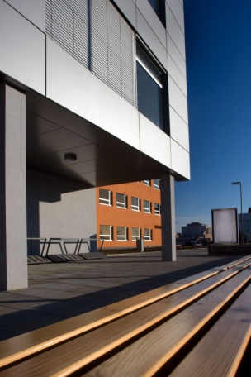
Who are we ?
Business Incubator VSB-TU Ostrava is a part of VŠB- Technical University of Ostrava
2005 was designed as part of building innovation and R&D infrastructure emerging Centre for Advanced Innovative Technologies "CPIT“).
In the following period, CPIT prepared successful projects to the EU Structural Funds for the construction of the building and launch of activities of the Business Incubator of Technical University of Ostrava ("PI") and its components, the Regional Technology Transfer Centre (RCTT).
2008 Business Incubator was opened

Slide 3
What is our mission ?
Comprehensive support for innovative start-up companies and innovative projectsof mature companies
Services related to technology transfer for businesses and universities
Motivating students and graduates to business
Support and development of innovation infrastructure in the Region
Our main aim is to support the bearers of ideas and know-how in the initial phase of business and help them to realize and fulfill their business visions.
Through its activities extend R&D activity of VSB-TUO towards the promotion and implementation of innovation on a commercial basis.
Offering a protected environment for start-ups and innovative companies. Involvement into the process of transfer of knowledge and technology.
Our mission is to accelerate the growth and success of emerging companies through supporting products, especially services.
Organizationally create an environment for the emergence of new companies, strengthening the possibility of using new knowledge and technology on a commercial basis.

Slide 4
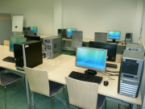
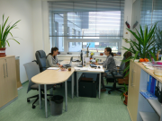
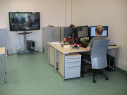
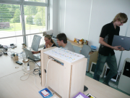
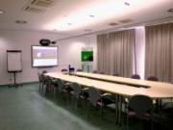
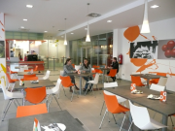
Premises for business…
The business incubator provides young, innovative, emerging companies, attractive office space rental, pilot plant space, meeting space and additional space at bargain prices.
The offer of space for business builds a set of complementary advisory and administrative services to young companies to help overcome initial problems and achieve market success.
► boardroom,
► seminar room, ► computer lab,
► residence hall,
► bistro
► modern and flexible office space,
► virtual offices,
► pilot/laboratory and additional facilities (the server, storage, parking),

Slide 5
Consulting - Support and development of innovative business
Through professional consultants we offer advisory support in smaller units and in a flexible time.
Directly or indirectly we provide development and technical consultig services in the form of so called „Packages“, which are listed on the menu of our Business incubator VSB-TU Ostrava.
Incubated companies get our advice on concessional terms, or completely free!
Set-up company
Assessment and improvement of novelty products
Commerzialization
Financial
Patend Fund
Marketing
Company performance
Intelectual property
Propagation
Courses and training
HR
We know, space are not all!!!

Slide 6
Who can be our client ?
This is essentially a start-up of entrepreneurs from the academic staff, students, graduates or already operating companies and companies with an innovative idea or plan, which can show links to research and development of universities and research institutes in the Region.
Academic
Student
College graduate
Innovative companies with links to research and development
Spin-offs from universities and operating companies
Another group with an innovative idea or intention of fulfilling at least two characters in the section "Signs of the innovative project / company“

Slide 7
What are the signs of an innovative project / company ?
Project owner / company must meet at least two characters below:
The applicant of projects
Type of business and product
Innovative small and medium-sized enterprise (SME)
Long-term cooperation on R&D
In-house innovation potential
Technology transfer and industrial property rights protection

Slide 8
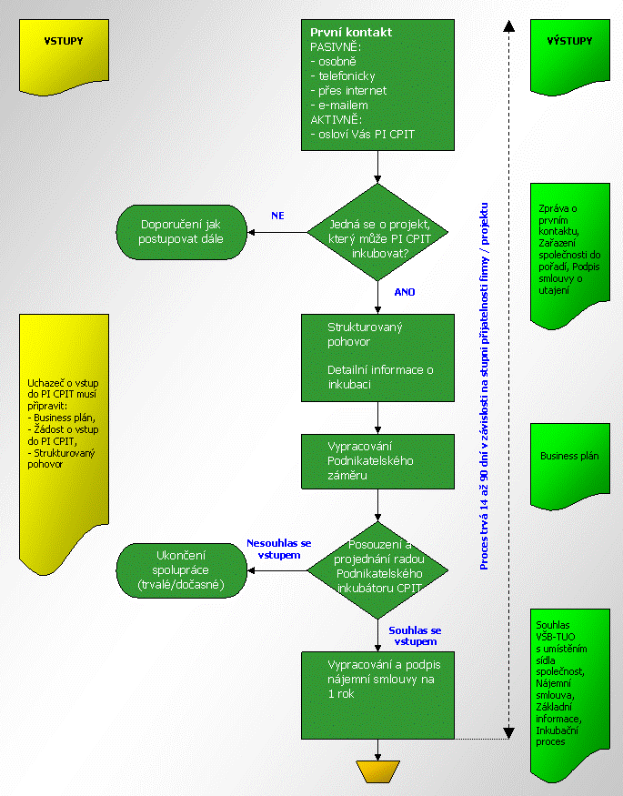
How does the process of adopting firms to PI work?
First contact
Application for admission to the BI
Meeting of the Council of Business Incubator
Decisions on acceptance / rejection of the project / company to BI
Signing a lease

Slide 9
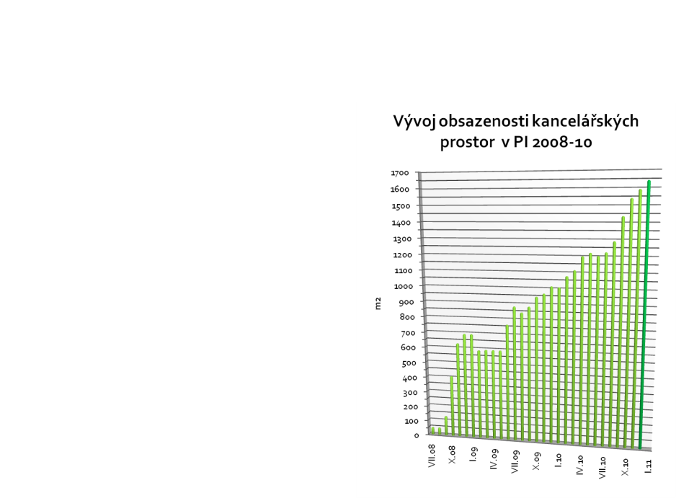
Incubator in numbers…
Development of office space occupancy in BI 2008-10
3 years of operation of BI
2000m² leased office and laboratory
space
90% availability
35 incubated companies
4 Successfully completed incubations
120 jobs in incubated companies
7 employees in BI
6 Trainees in BI

Slide 10
Type of incubated companies

Slide 11
Project AGENT
The main aim: with a partner network to ensure effective interconnection of specialized technicalservices partner universities and R&D centers to demand business and public sector so that a useful place for information transfer and the resultant increase in the use of the commercial potential of universities and R&D organizations.
The most important outcome is the network of "technology scouts" and "contact managers", which serves as a connecting bridge between the academic and application spheres.

Slide 12
Project AGENT
Technology Scout monitors the environment and the needs within the organization and seeks R&D results, suitable for commercialization.
Contact operations manager performs mediation between the university and businesses and actively seeks new opportunities for cooperation. He also handles liaison office and a newly developed information system and supply and demand portal.
The office helps companies interested in cooperation with the university or R&D organizations navigate the complex structure of workplaces and provides access to know-how and equipment of specialized university departments.

Slide 13
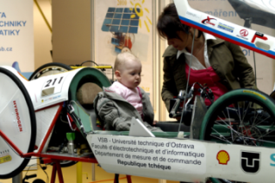
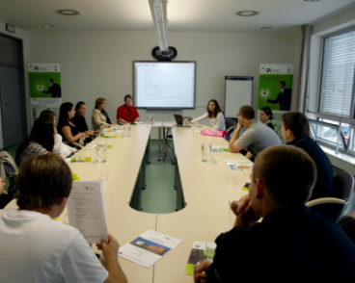
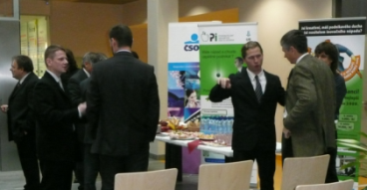
And much more …

Slide 14
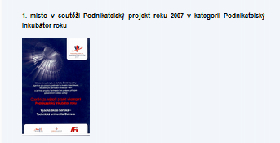
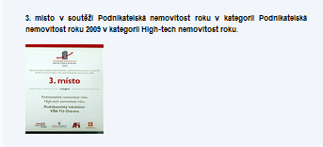
Significant results …
1st place in the competition Business Project of the Year 2007 in category Business Incubator of the Year
3rd place in the competition Business Property of the Year in category Business Property of the Year 2009 in category High-tech Property of the Year
3rd place in the competition Business Property of the Year in category Business Property with the Greatest Benefit for Innovation.

Slide 15
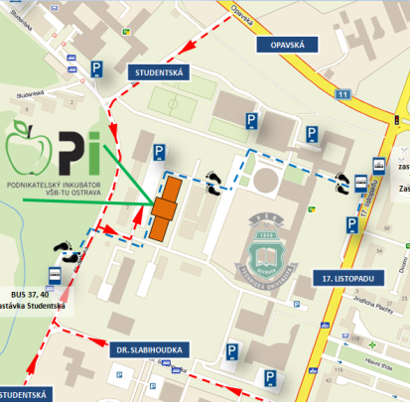
Contact…
Podnikatelský inkubator VSB-TU Ostrava Studentska 6202/17 708 00 Ostrava-Poruba
GPS: 49°50'1.93"N; 18°9'36.72"E
Tel. : +420 597 329 003 Mobil: +420 603 565 918
E-mail : inkubator@vsb.cz web: www.cpit.vsb.cz/inkubator/

