Slide 1
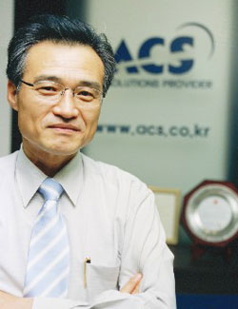
M2M with SaaS(Software as a Service) in Cloud Computing
S. K. Cha
Cofounder & CTO
ACS Co., Ltd.
skcha@acs.co.kr

Slide 2
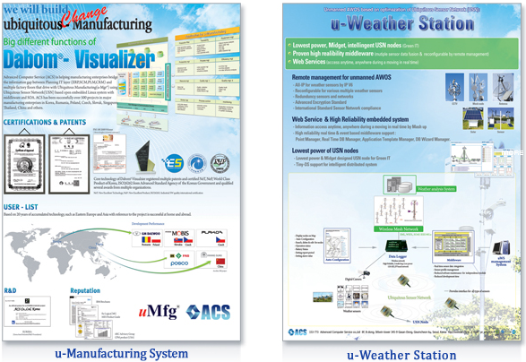
Who is ACS?
Since August 30, 1988 (23 years)
  Concentrating real time based manufacturing software – u-Manufacturing (uMfg® & Dabom®)
  DABOM®-MES has successfully completed over 500 project including Hyundai Kia Motor, POSCO
  Announced DAOM®-MES Version for SME in FY2002 and currently more than 200 references
  Completed R&D for u-AWS(Automatic Weather Station) in FY 2011 for KMA(Korea Meteorological Administration)
  ACS software installed in Romania, Poland, Slovakia, Czech, Singapore, Thailand, China and more
ACS Facts
  Capital : USD 1.4 Million
  Annual revenue: USD 18M(2010), 20M(2011)
  No of employees : 75
  R&D: 7.5% of Revenue (1.2M) in 2009
  (EU EUREKA, FP 7, IMS, KORIL , Local R&D project)
Main Business
  Consulting services for Mfg. IT & Real time application
  Dabom®-Application – MES SW for global manufacturing
  Dabom®-Middleware – Real time driven
  Dabom®-Device – M2M(Machine to Machine)
Core Technology
  u-Mfg® middleware (Dabom®) - (NeT, NeP, World Class Product, ES-ISO12119 certification)
  Lean Mfg. - 4 Zero (Waiting time, Inventory, Defects & Down-time) method - (Patent No: 10-0545737)
  Ubiquitous Manufacturing & Collaborative Manufacturing - (Patents No:10-0695533 & 10-0788009)
  Auto-Configuration® - (Patents No:10-2008-0084699)
  Automatic weather monitoring system using ubiquitous sensor technology – (Patents No: 10-2009-0068912)
  Predictable maintenance system for CNC technology (Patents No.:10-2009-0002861) – with KIMM

Slide 3
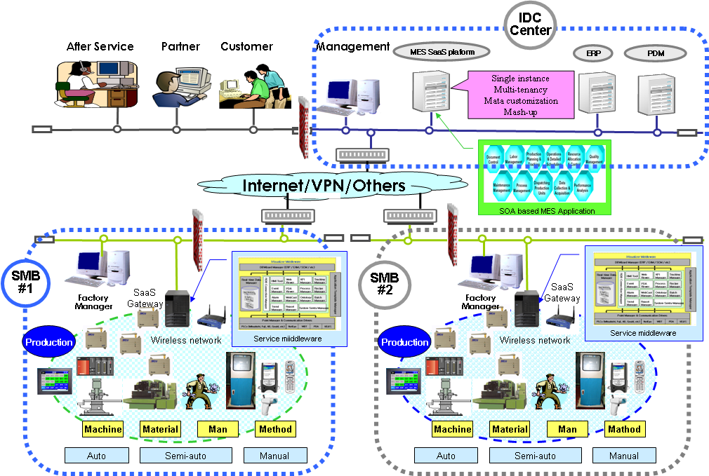




Scope of Joint R&D
Scope of M2M and Cloud computing
Core technology of SaaS (Software as a Serviece) based MES system for Small business enterprises
1. Wired/Wireless sensor based production resources interface device in real time – M2M
2. Service oriented middleware runs under gateway - Production knowledge based operation
3. Single instance SOA MES application for automotive & Electric, Electronics industry – Cloud computing
Green IT
③
②
②
①
①

Slide 4
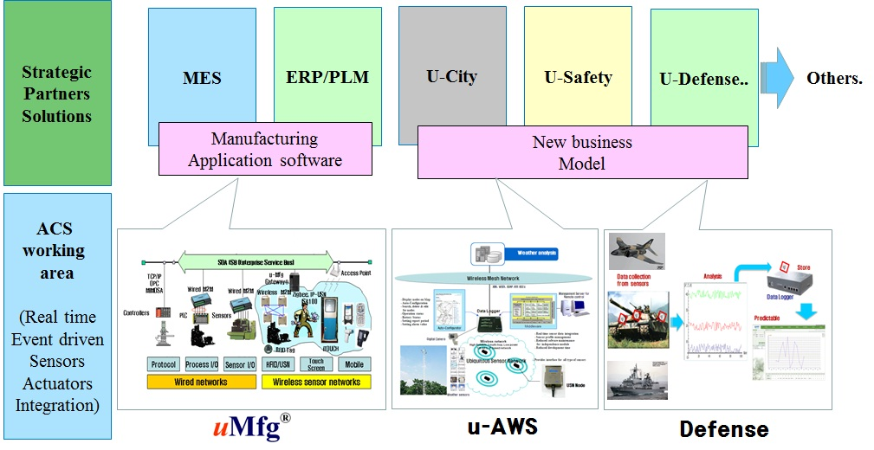

Expectation
We are very interested in M2M based Open Innovation Collaboration Global R&D Project opportunity
EUREKA Project
FP 7 Project
International Joint Project runs under MKE (Ministry of Knowledge Economic) Local Program
Others
Sensor Cloud

