Slide 1
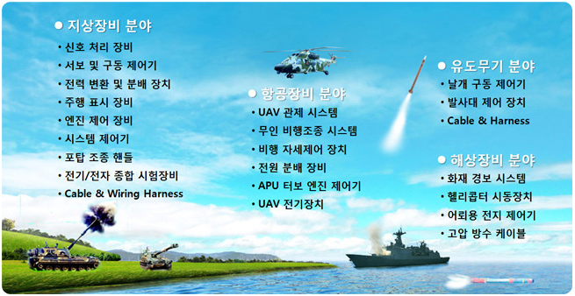
BUSINESS FIELD (사업분야)

Slide 2
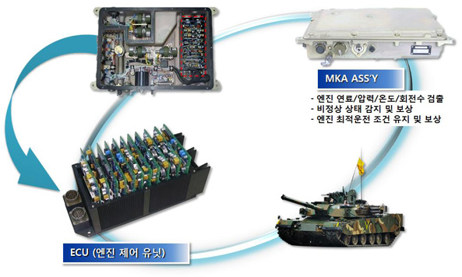
GROUND EQUIPMENT
K1
( K1 TANK)

Slide 3
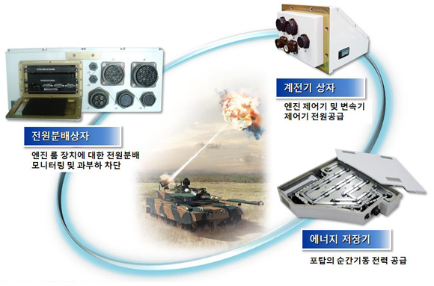
GROUND EQUIPMENT
K2 (흑표 전차)
Relay UNIT
POWER DISTRIBUTION UNIT
Energy Storage Container
( Black Panther TANK)

Slide 4
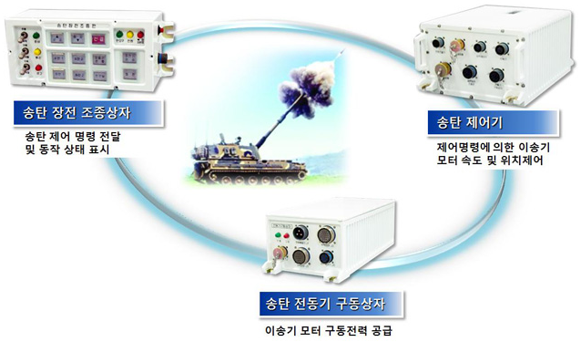
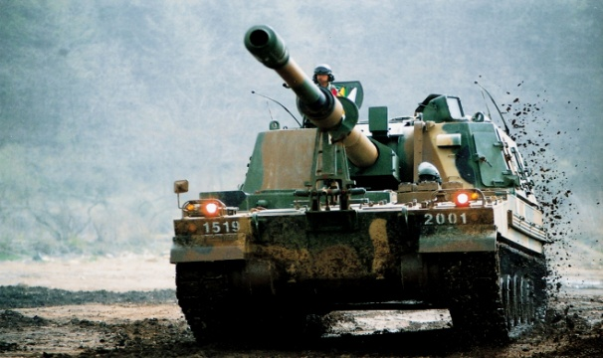
GROUND EQUIPMENT
K9 (자주포)
BULLET LOADING CONTROLLER
Bullet Transfer CONTROLLER
Bullet Transfer Motor CONTROLLER
(Self-propelled artillery)

Slide 5
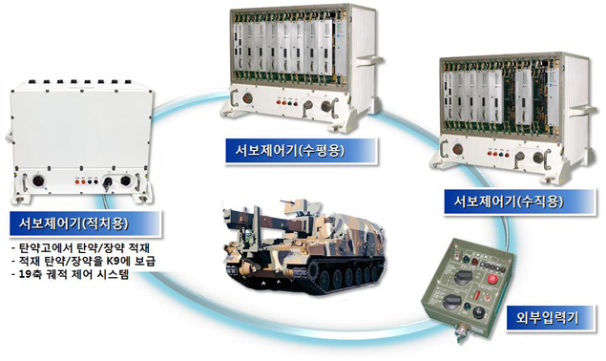
GROUND EQUIPMENT
K10 (탄약 운반차)
SERVO CONTROLLER(HORIZONTAL)
SERVO CONTROLLER(VERTICAL)
SERVO CONTROLLER
External Input Module
(Ammunition Vehicle)

Slide 6
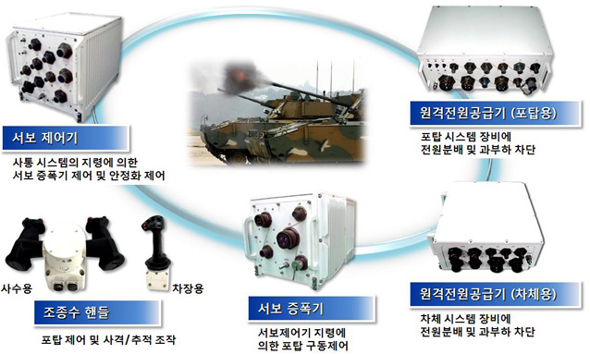
GROUND EQUIPMENT
K21 (공격형 장갑차)
SERVO CONTROLLER
REMOTE POWER SUPPLY(TURRET)
OPERATOR HANDLE
SERVO AMPLIFIER
REMOTE POWER SUPPLY(BODY)
Armored Vehicle (Armed)

Slide 7
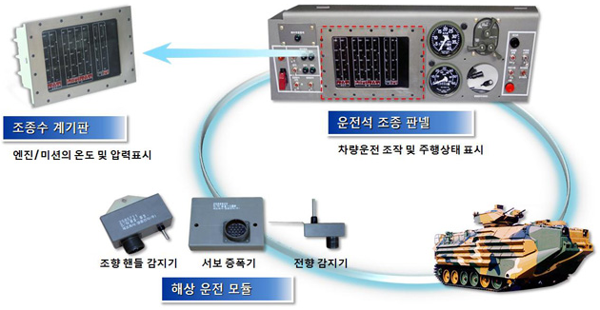
GROUND EQUIPMENT
KAAV(상륙돌격장갑차)
Instrument Panel
Operator Control Panel
Marine Driving Module
Assult Armored Vehicle

Slide 8
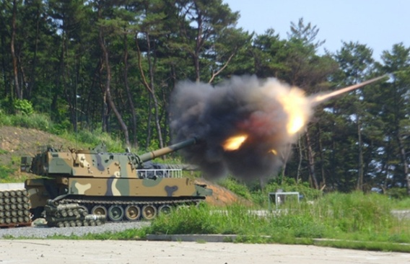
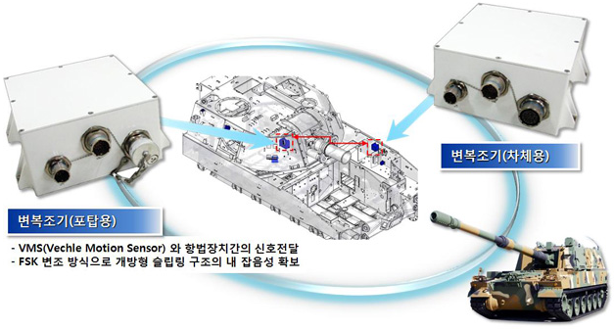
GROUND EQUIPMENT
K55A1(자주포)
Modulator &
Demodulator
Modulator &
Demodulator
Self-propelled artillery

Slide 9
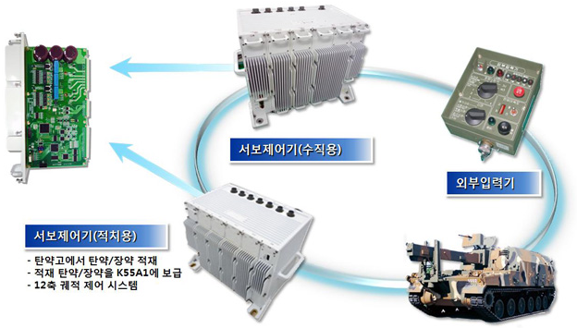
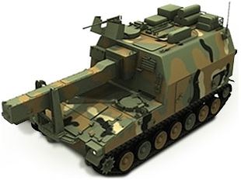
GROUND EQUIPMENT
K56 (탄약운반 장갑차)
SERVO Controller (V)
SERVO Driver Board
External Input Module
SERVO Controller(Main)

Slide 10
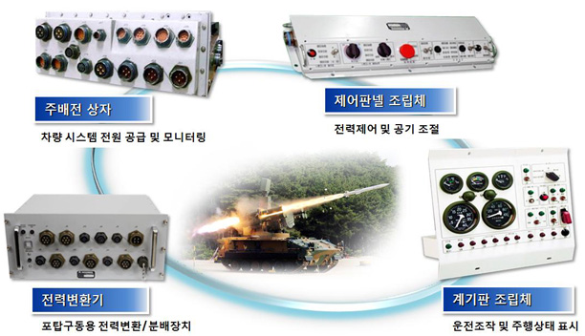
GROUND EQUIPMENT
CHUNMA (천마)
Main SUPPLY Unit
Control Panel Module
POWER Converter
Instrument Panel Unit

Slide 11
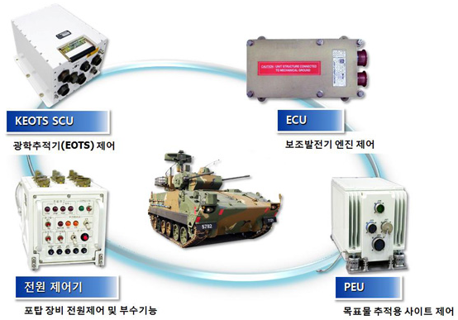
GROUND EQUIPMENT
BIHO (비호)

Slide 12
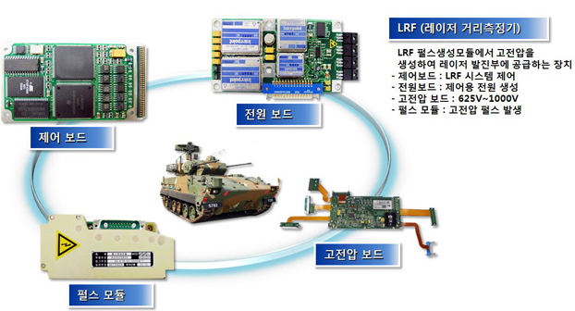
GROUND EQUIPMENT
BIHO-II (비호2)
POWER Board
CONTROL Board
HIGH VOLTAGE Board
PULSE Module

Slide 13
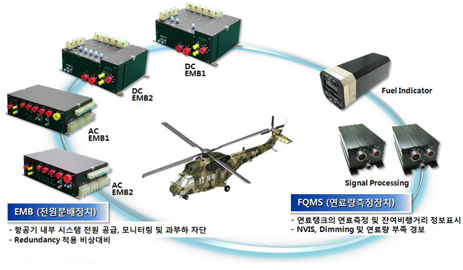
AVIATION EQUIPMENT
KUH (다목적 헬리콥터)
FUEL Measurement Equipment
POWER Distribution Unit

Slide 14
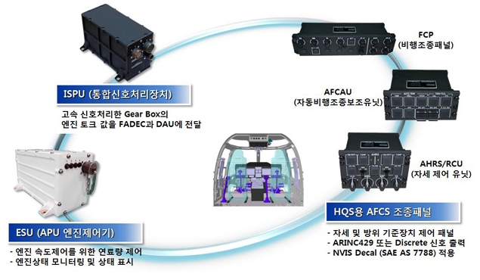
AVIATION EQUIPMENT
KUH-II

Slide 15
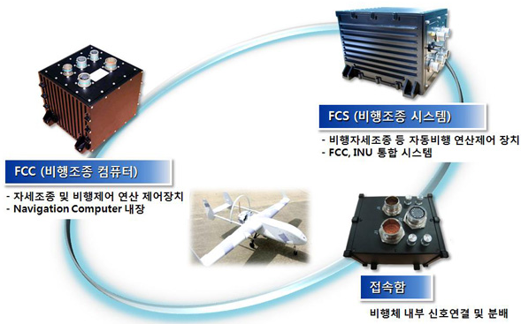
AVIATION EQUIPMENT
UAV (무인 정찰기)
FLIGHT CONTROL SYSTEM
FLIGHT CONTROL COMPUTER
Unnamed Aerial Vehicle

Slide 16
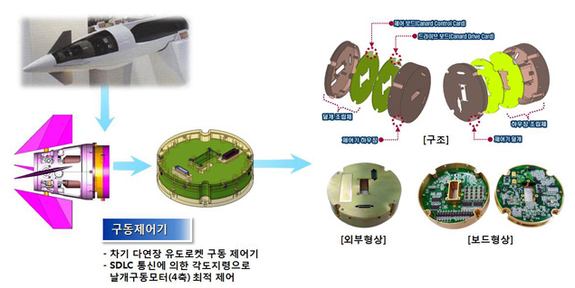
GUIDED WEAPON (유도무기)
CHUNMU (천무 : 차기 다연장)
HIMARS

Slide 17
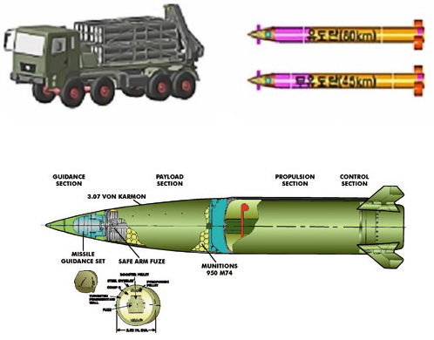
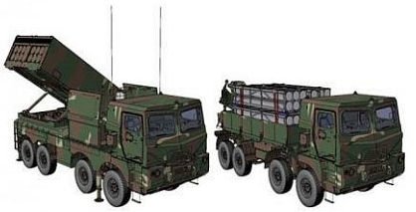
GUIDED WEAPON (유도무기)
CHUNMU (천무 : 차기 다연장 로켓)
HIMARS

Slide 18
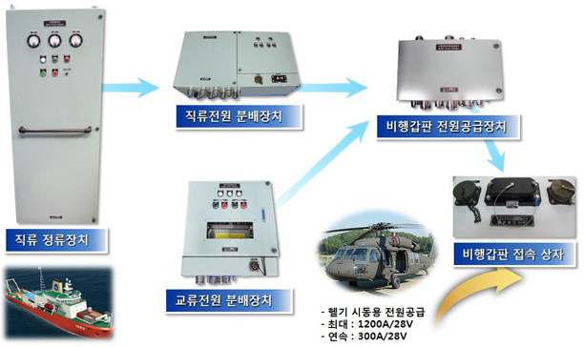
NAVAL EQUIPMENT
HSS
DC. Rectifier Equipment
DC. POWER Distribution Equipment
Flying Deck
Power Supply Equipment
AC. POWER Distribution Equipment

Slide 19
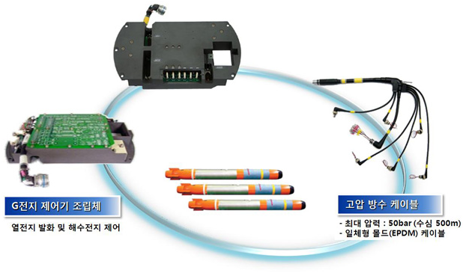
NAVAL EQUIPMENT
TORPEDO (어뢰 : 청상어)
TORPEDO

Slide 20
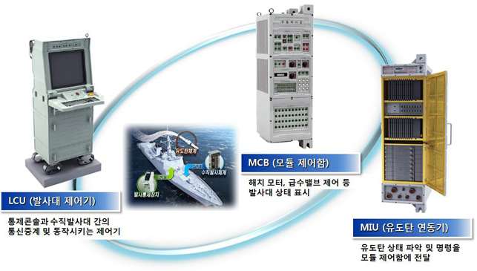
NAVAL EQUIPMENT
KVLS (홍상어)
TORPEDO

