Slide 1
National program of sustainability What slows us in getting fully involved in EU programs ?
Prof. RNDr. Dalibor Štys CSc.
MEYS Czech Republic

Slide 2
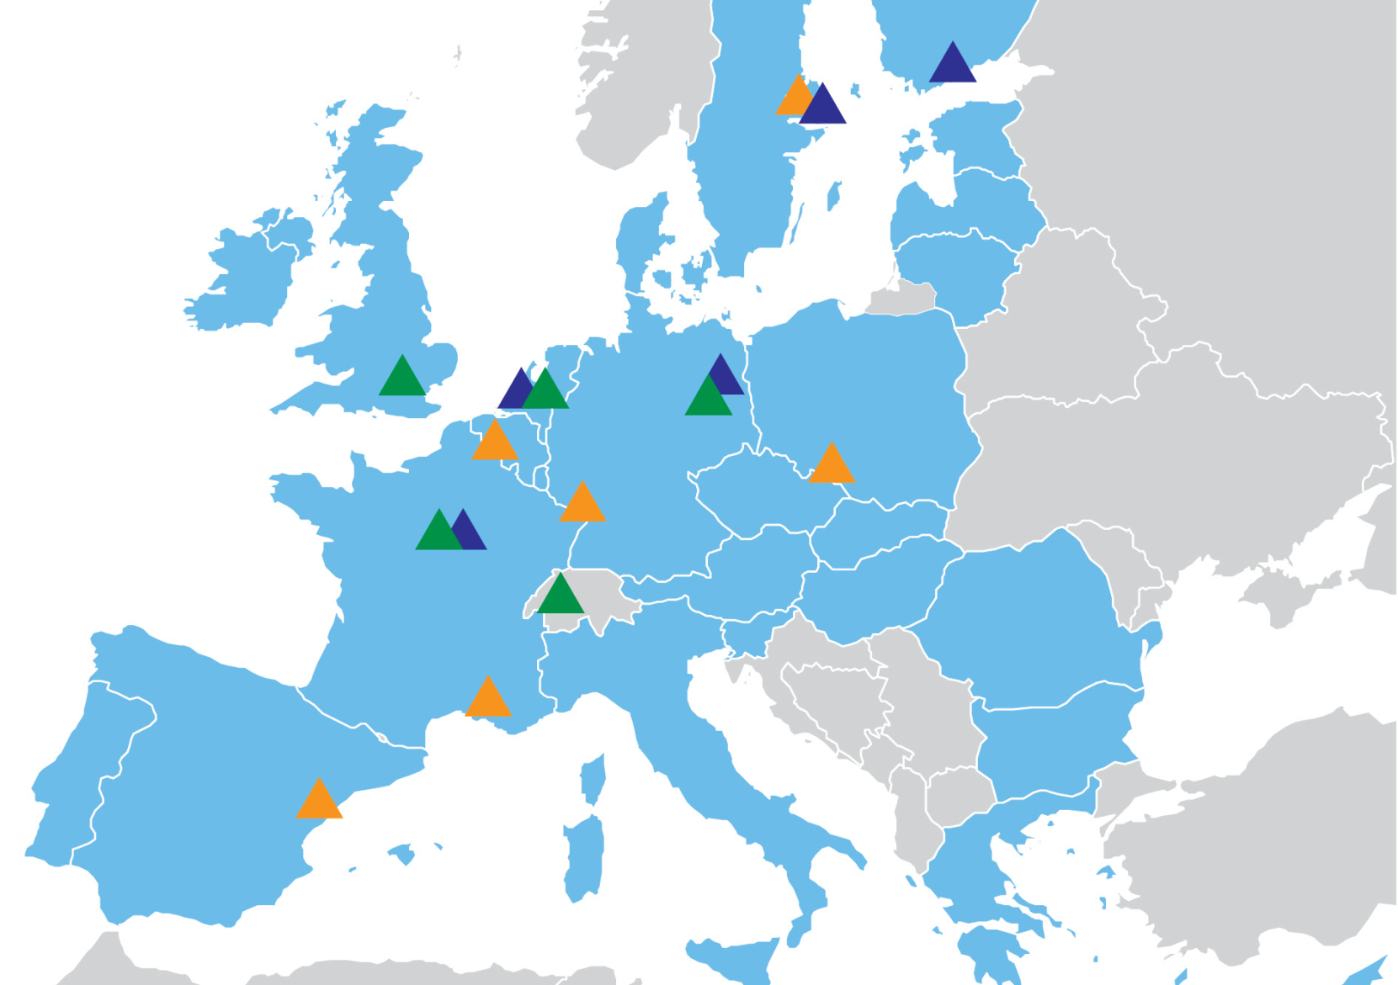

Slide 5
General goals of Czech science
In my position they are:
1) Gain of the knowledge into the Czech Republic through international academic community. For that we have to be able to contribute,
to have sufficient quality,
to be able to communicate, i.e. first of all publish in a trustworthy way, to give lectures, to organise scientific conferences and courses, to produce open source softwares and algorithms, to run specialised web pages etc.
to be to able to absorb, namely scientist from abroad, our own returnees, high quality researchers from the industry. The biggest crime of the Czech scientific community is inbreeding, when scientist continue in one team from master thesis up to professorship.

Slide 6
General goals of Czech science
In my position it they are:
2) Transfer of knowledge to Czech subjects
Students
Industry via consultations, research contracts, spin-off companies, joint projects etc.
Broad public via teachers, educated promoters of science, journalists etc.
3) To bring to the Czech Republic money from the international sources to which we contribute. In this (easily understandable) aspect we fail in a long term. This is in most cases due to our failure in 1) and 2) .
These activities are performed by people in research teams and through university lecturing. These activities are inseparable.

Slide 11
What do we do at national level?
We change of the university law to support excellence and professional education
We build research infrastructures from RDI program and finance National program of sustainability
We prepare new science evaluation methodology

Slide 12
National program of sustainability
General philosophy of the program is that applicants to VaVpI project already declared the ambition to support the excelency at regional level and passed the test of international evaluation. National program of sustainability should support this ambition, which implicitly means also that NPS evaluates to which extent the new centres are able to withstand international criteria of R&D quality.

Slide 13
8.4 Theshold criteria of successfull fulfillment of the project of NPS I I
Successfull conclusion of at least one international collaboration project of duration of at least 12 months
Successfull conclusion of at least one industry collaboration project of duration of at least 12 months
Successfull conclusion of at least one collaboration project with regional authority of duration of at least 12 months

Slide 14
8.4 Theshold criteria of successfull fulfillment of the project of NPS I I
For successful fulfillmnet of the NPS project there must be completed :
At least five international collaboration or industry collaboration projects lasting at least 12 months.
Fulfillment of at least one industry stay of the researcher of the center in private industry research laboratory of duration 1 to 6 months.
Fulfillment of stays of at least 20% of the project employees in foreign research laboratories lasting 1 to 6 months.

Slide 15
This is a pilot test of measures to support R&D excellence
Thank you for your attention

