Slide 1
Regional Workshop
“Work Based Learning - future co-operation: regional workshop”
We do it in Romania, Timisoara
Vienna, Austria / October 13 - 14, 2014

Slide 2
DURA AUTOMOTIVE ROMANIA’S EXPERIENCE
HR manager
Adrian Alpredi

Slide 3
Content
Very short Plant presentation
DURA’s contribution to educational system
Case study-our approach about internship

Slide 4

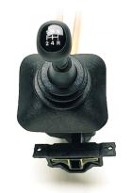
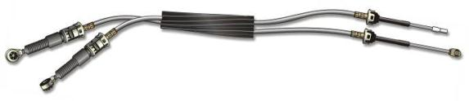
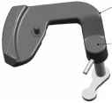
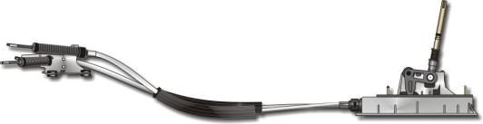
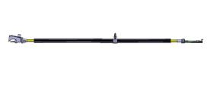
DURA Automotive Romania - products-cable systems and manual shifters
Park Brake cable
Park Brake Cable
Hood release cable
Accelerator Cable
Release Cable
MTX - Cable
Shifter
Door Cable
Shift Control
Cable - Shift Systems

Slide 5
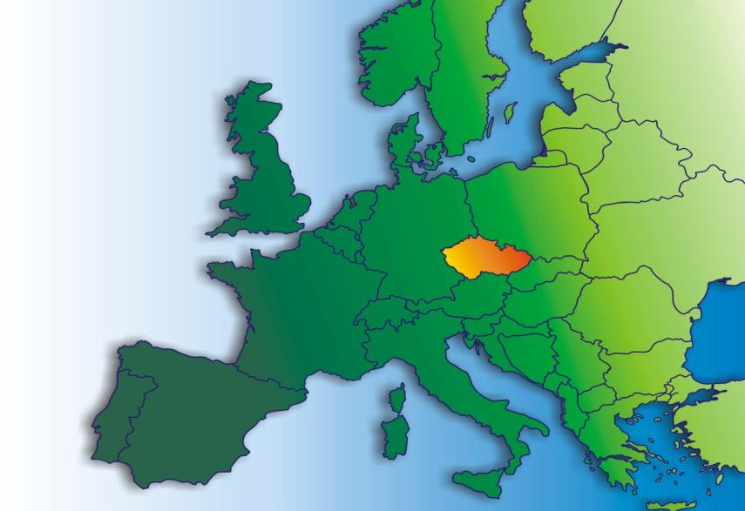




DURA Automotive Romania, Customers
GOTTEBORG
SUNDERLAND
Daventry, NORTHAMPTON
GENK
WUPPERTAL,Hilden
DOUAI
KOPRIVNICE
SANDOUVILLE
Rastatt
COBURG
Sindelfinden
TIMISOARA
NOVO MESTOI
PITESTI
PALENCIA
TONDELA
KOCAELII
BURSA

Slide 6
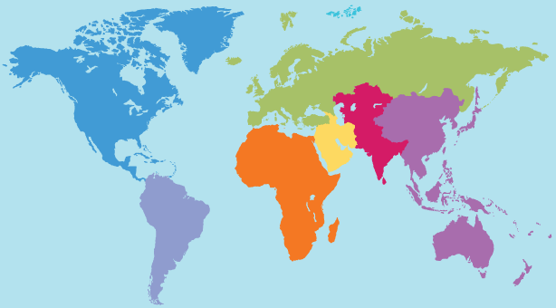
DURA Automotive Romania, Customers
TIMISOARA
KOCAELII

Slide 7
DURA’s contribution to educational system
  Starting with 2010 we have been participating in different projects regarding educational system. Only in former school year 2013-2014, we have assured internship for 89 students from 3 technical high schools and 22 from “Politehnica” University, and have organized visits in our factory for other 140 students.
  The internship is based on a contract between company, school/faculty and students.
  For high schools, the internship lasts 6 weeks and is addressed to Mechatronic, Automation or Mechanical qualifications
  The facilities offered by us are:
  - transportation to/from company (9.000 eur/year);
  - protective and labor equipment (T-shirts, safety glasses and shoes);
  - access to production equipment;
  - training room;
  - specialists.

Slide 8
Case study - Internship for technical high school
Organization of internship-first stage
  Internship is organized based on Curricula for each qualification in 2 stages of 3 weeks each:
  Mechatronics technician (XII grade):
  - Pneumatic actuators in mechatronics
  - Hydraulic actuator in mechatronics
  - Planned Maintenance
  - Detecting defects
  Mechanical technician for maintenance and repairs (XI grade):
  - Motion transmission systems
  - Measurement techniques
  - Mechanical assembly
  - Industrial Machinery
  - Wear of machinery and equipment
  - Health and safety at work

Slide 9
First day-is not only a schedule
  There is a preset program to assure induction and safety training but also to give a direction for this activity and communicate the expectations regarding this activity to students. Implication of managerial level shows the importance we give to this activity. Mind setting is very important.
45 min – Power point presentation (Manufacturing Manager)
2 hours – H&S training (HSE specialist)
30 min - break
1 hour– Plant tour (Manufacturing Manager)
30 min – distribution of work and safety equipment
1 hour – Organizational activities: assigning tutors, organizing groups and departments, (Manufacturing and Maintenance Managers).

Slide 10
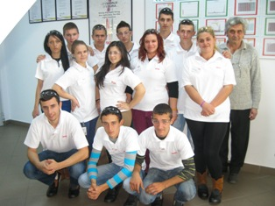
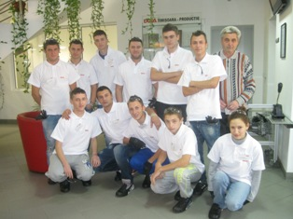
DURA’s employees are informed about students presence and the purpose of internship, in order to treat them as students, help and take care of them. Students start to feel that are part of DURA environment.
First day-is not only a schedule

Slide 11
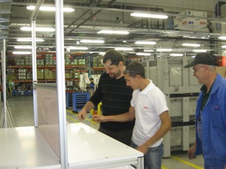
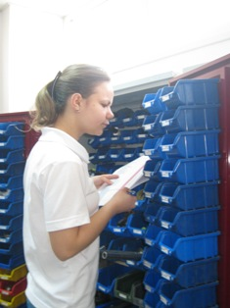
Conducting practice-Maintenance Department
  Along the internship, students are splitted in groups and rotated in Maintenance and Manufacturing Departments, where are trained as much as possible according with curricula.

Slide 12
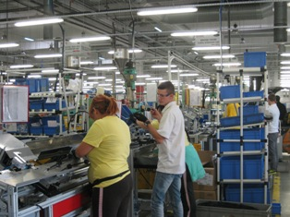
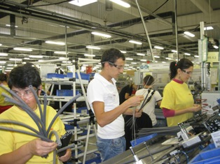
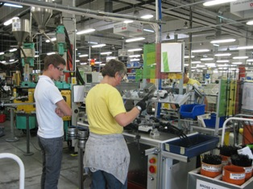
Conducting internship – Manufacturing Department
Students are asked to observe how the machines work and the role of each device. Also they observe the workers.

Slide 13
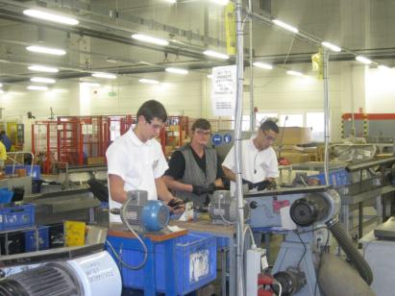
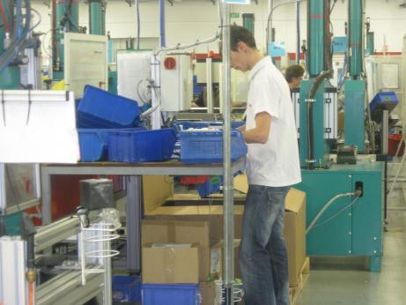
Conducting internship – Manufacturing Department
Students participate to production process, making simple but important operations for …..

Slide 14





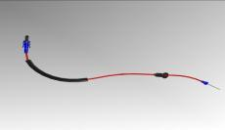
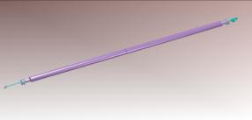
Plant Timisoara, Platforms
Daimler, B-Klasse, W246
Daimler, C-Klasse, W204
Daimler,E-Klasse, W212
Mercedes S-Klasse, W222
Mercedes S-Klasse, W222
Door Cable
BURSA

Slide 15
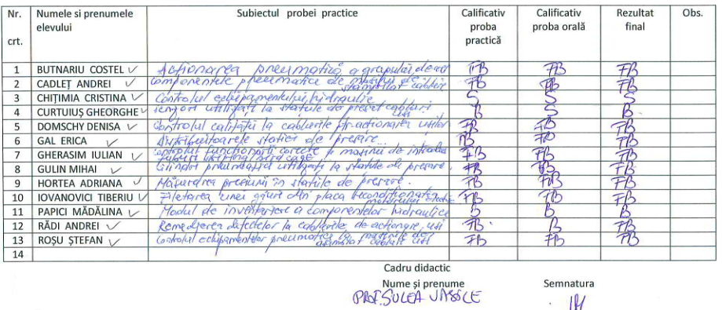
Technical assessment
  The teacher assesses the acquired professional knowledge, both practical and theoretical

Slide 16
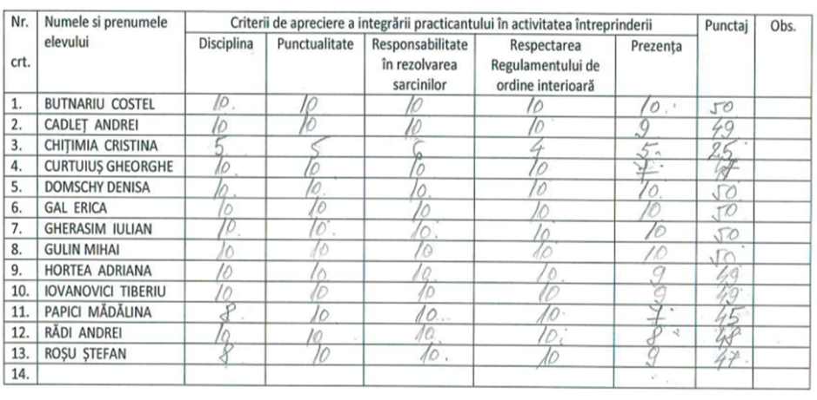
Behavioral assessment
  Students must evolve also from behavioral point of view, adapting to a new environment. Used criteria: discipline, punctuality, responsability, attendance.

Slide 17
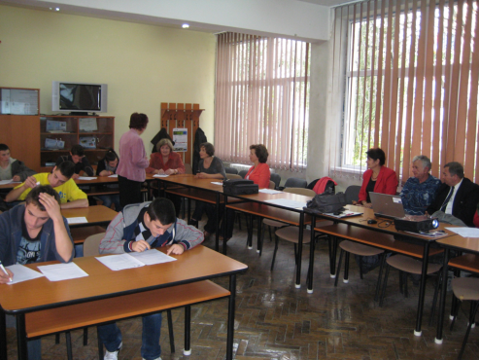
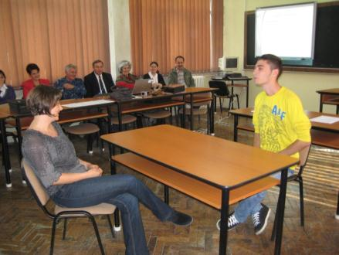
Organization of internship-second stage
  In addition to activities from first stage, which took place in the second as well, at the end of second stage, we have organized a contest based on practical and theoretical knowledge.
  Both in the factory as well as at school, we have organized career guidance activities, which included simulation of job interviews.

Slide 18
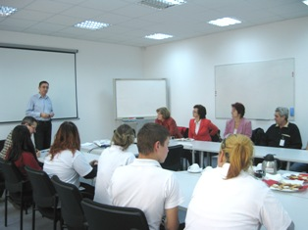
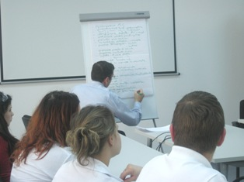
End of internship-final meeting
  A final meeting took place in order to give and receive feedback. It was a good opportunity to assess the effect of internship on students and counsel them for the future. A few findings: they became more disciplined, responsable, have assimilated very fast a lot of information, have shown curiosity, which was a real surprise for their teachers.

Slide 19
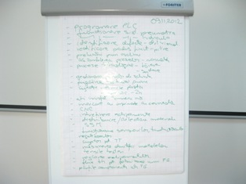
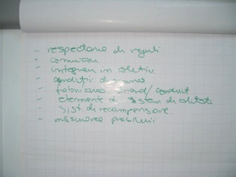
Feedback from students

Slide 20
Awards ceremony
  DIPLOMA
  Se acorda elevei __________, din clasa a XII-a A, Colegiul Tehnic ELECTROTIMIS, localitatea Timisoara, Judetul Timis, pentru absolvirea cu rezultate foarte bune a stagiului de practica efectuat in perioada 29.10 – 09.11.2012, in cadrul firmei SC DURA AUTOMOTIVE ROMANIA SRL
  Director General 09.11.2012

Slide 21
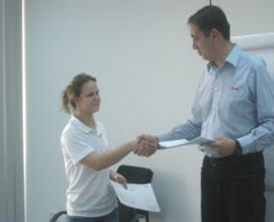
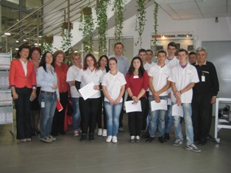
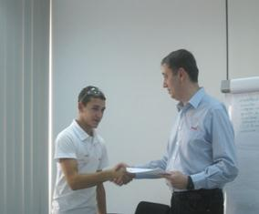
Awards ceremony

Slide 22
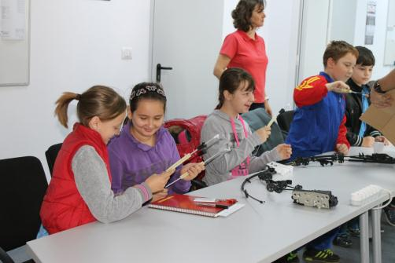
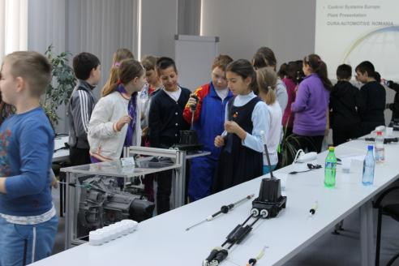
This is the future! Sooner is better!

Slide 23
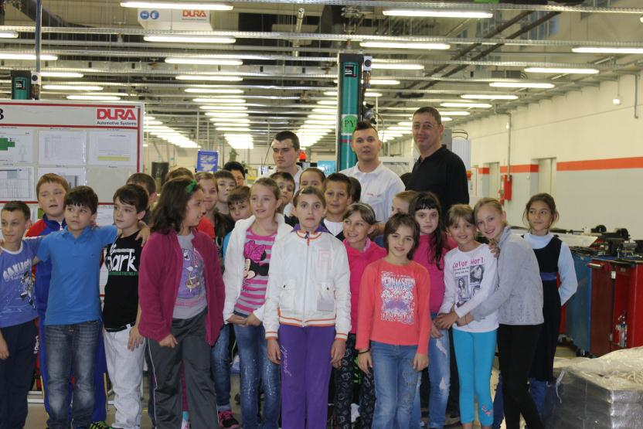
I believe in this and I am doing it! But is it enough?

Slide 24
  This is what we do in Romania!
  Thank you for your attention!
  Adrian Alpredi-HR Manager
  DURA Automotive Romania SRL
  www.duraauto.com

