Slide 1


European Molecular Biology Laboratory
Introduction and links to Member States
Dr Silke Schumacher
Director International Relations

Slide 2
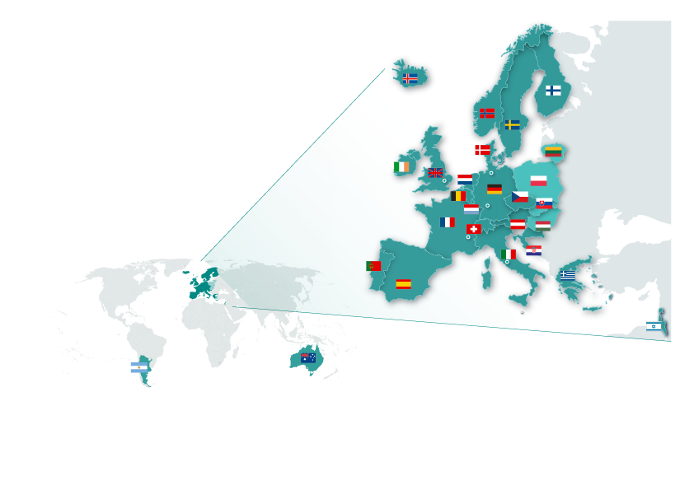
EMBL Member States
Member States 21
Austria 1974
Denmark 1974
France 1974
Germany 1974
Israel 1974
Italy 1974
Netherlands 1974
Sweden 1974
Switzerland 1974
United Kingdom 1974
Finland 1984
Greece 1984
Norway 1985
Spain 1986
Belgium 1990
Portugal 1998
Ireland 2003
Iceland 2005
Croatia 2006
Luxembourg 2007
Czech Republic 2014
Associate Member States
Australia 2008
Argentina 2014
Prospect Member States
Slovakia 2014
Hungary 2014
Poland 2014
Lithuania 2015
And interest from other countries
Notes:
The European Molecular Biology Laboratory (EMBL) – Europe’s only intergovernmental laboratory in the life sciences – is a unique institution. It is Europe’s leading institution in the molecular life sciences, and one of the highest-ranked research institutes in the world.
As an intergovernmental organisation EMBL is governed and funded by its 21 member states and 2 associate (non-European) member states. In addition EMBL has 4 prospect member states with the intent to join EMBL over the next 3 years.
Associate and prospect member states have observer status on EMBL’s governing body, the EMBL Council, which is formed by delegates from EMBL’s member states.

Slide 3
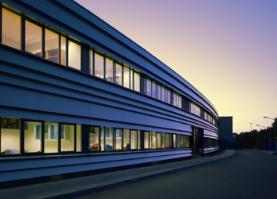
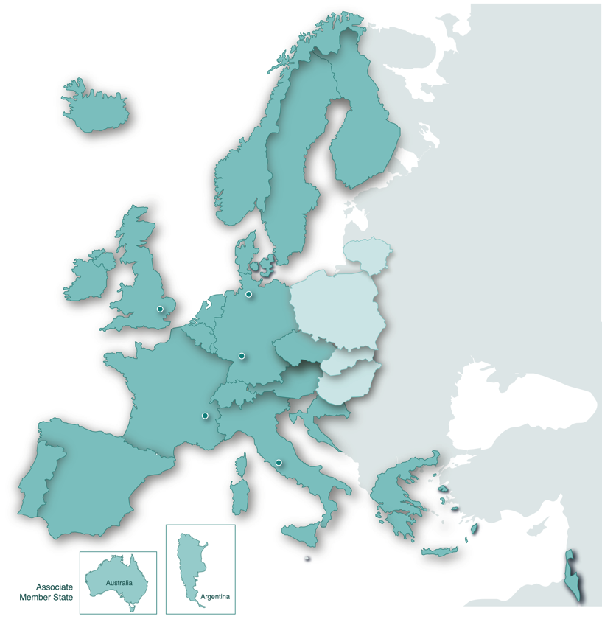

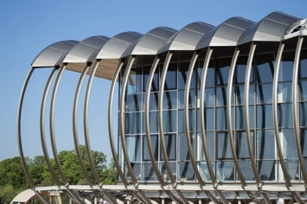
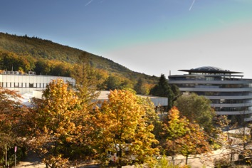

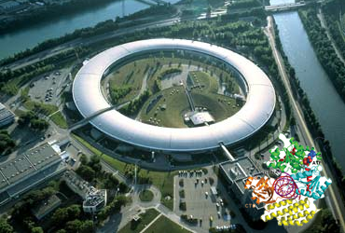
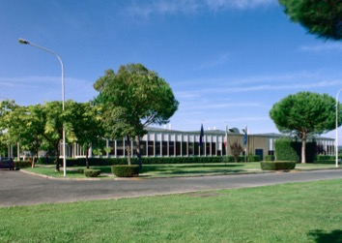

EMBL Sites
Hamburg (DESY)
Hinxton
Structural Biology
Heidelberg
Bioinformatics
Grenoble (ESRF)
Life Sciences
Monterotondo
Structural Biology
Mouse Biology
> 1600 people > 80 nationalities
Notes:
EMBL pursues cutting-edge research across its five sites in Heidelberg (the headquarters), Grenoble, Hamburg, Hinxton (European Bioinformatics Institute) and Monterotondo.
EMBL is not limited to recruiting nationals from its member states but has the freedom to recruit the very best in their fields. Across its five sites EMBL employs 1600 people (not counting visitors) from over 80 nationalities.

Slide 4
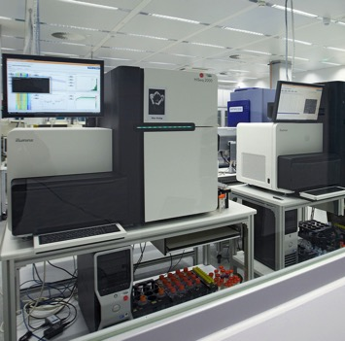
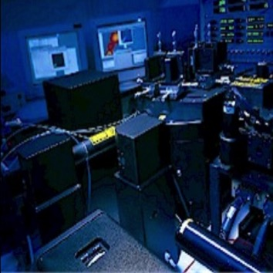
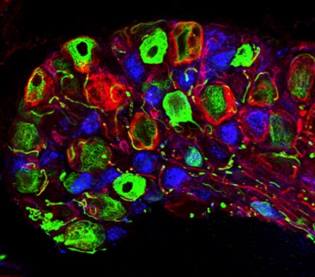
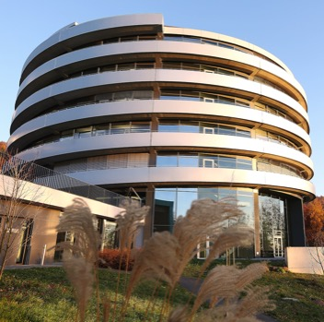
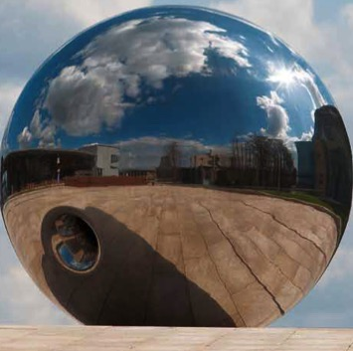
EMBL’s Five Missions
Technology
Development & Transfer
Services
Basic Research
Integration
of life science research
Advanced Training
Notes:
EMBL pursues five synergistic missions that, in combination, complement and provide added value to the activities of member state scientific communities.
1. Forefront research: uncovering the molecular basis of life
2. Providing world-class research infrastructure and services
3. Training and inspiring the next generation of stellar scientists
4. Driving research, innovation and progress through technology development, interactions with industry and technology transfer
5. Playing a leading role in the integration of life science research in Europe

Slide 5
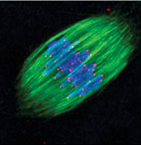
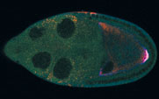
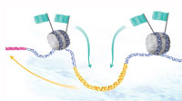
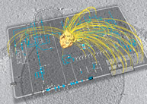

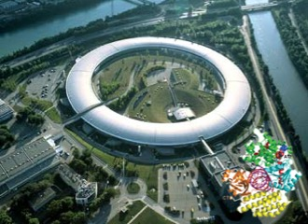
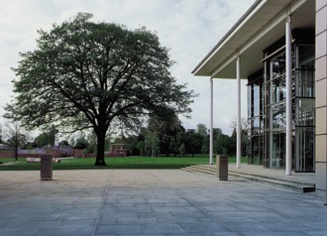


The EMBL Research Units
Heidelberg
+ Directors’ research, core facilities and central administration; EMBO
Cell biology and biophysics
Developmental biology
Genome biology
Structural and computational biology
Structural biology
– Hamburg
Structural biology
– Grenoble
European Bioinformatics Institute – Hinxton
Mouse biology
– Monterotondo
DESY – European XFEL
CSSB
ILL, ESRF, IBS, PSB
Wellcome Trust Sanger Institute
EMMA, CNR
Notes:
EMBL consists of 9 Research Units across its five sites.
The Units at the headquarters in Heidelberg focus on cell biology and biophysics, developmental biology, genome biology and structural and computational biology. In addition there is a small unit called ‘Directors’ Research’ that comprises the labs of the EMBL DG and Director, the EMBO Director and distinguished visitors. In addition EMBL Heidelberg houses the central administration and technical core facilities. EMBL shares its campus with its sister organisation, the European Molecular Biology Organisation (EMBO).
EMBL Hamburg and Grenoble are both dedicated to research and service provision in structural biology. Both units are located at the site of powerful X-ray radiation sources: the German Electron Synchrotron (DESY), and in future also the European X-ray Free Electron Laser (XFEL) and the European Synchrotron Radiation Facility (ESRF) in Grenoble. In addition, Hamburg is home to the Centre for Structural Systems Biology, a joint initiative of nine research partners from northern Germany including three universities and six research institutes, one of them EMBL Hamburg. In addition to EMBL and the ESRF, the Grenoble campus also houses the Institute Laue Langevin (ILL, with its neutron source) and the French Institut de Biologie Structurale. Together with ESRF, ILL and IBS, EMBL Grenoble engages in the local Partnership for Structural Biology (PSB).
The European Bioinformatics Institute is located on the Wellcome Trust Genome campus that also houses the Wellcome Trust Sanger Institute with which EMBL-EBI collaborates closely.
EMBL Monterotondo, close to Rome in Italy, focuses on mouse biology and is located on the same campus as the European Mouse Mutant Archive (EMMA) and the Italian Research Council (CNR).

Slide 6
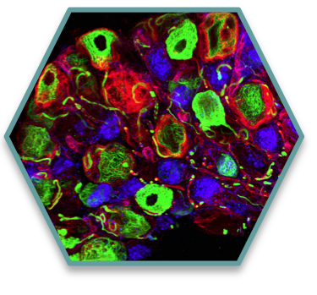

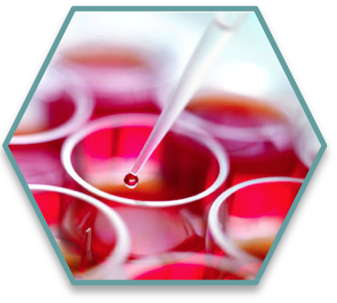
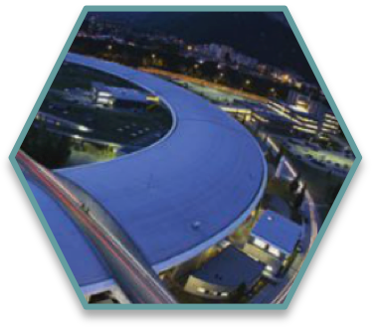
EMBL’s Core Principles
Combination of synergistic missions
Scientific excellence
Internationality
and
diversity
EMBL
Cutting-edge infrastructure
Continuous staff turnover
Opportunities for young creative thinkers
Early independence
Notes:
Since its foundation in 1974 EMBL has grown and evolved a lot. Its founding principles have however remained at its core until today.

Slide 7
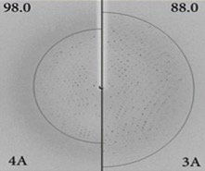
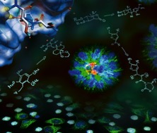

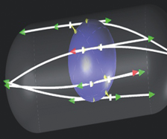
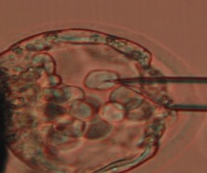
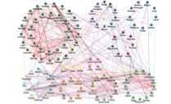
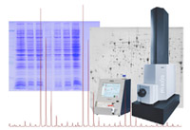
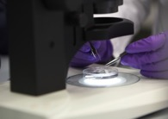
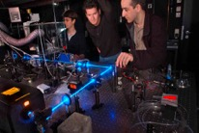
EMBL Environment for Young Researchers
Interdisciplinary Research – research beyond molecular biology
Collaborative environment
Infrastructure and support
Focus on research,
few other tasks (e.g. teaching)
Physics
Chemistry
Computational Biology
Modelling
Medicine
Notes:
EMBL’s scientific excellence and cutting-edge infrastructure, along with a culture that promotes intellectual freedom and flexibility, create a vibrant environment that offers unmatched opportunities to young creative scientists.

Slide 8
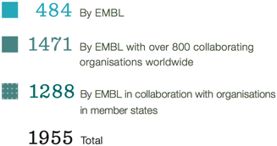
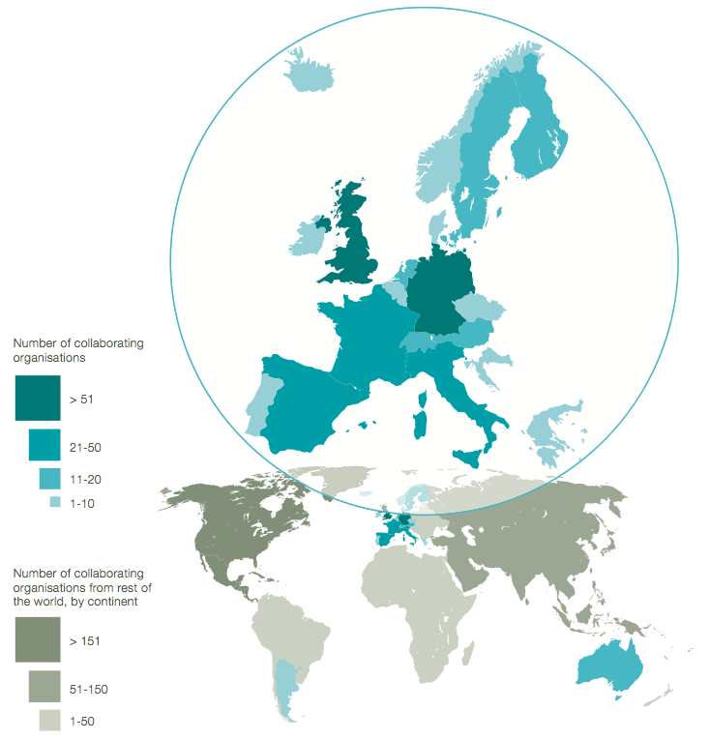
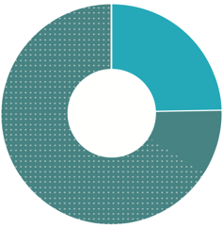
Scientific publications in collaboration in 2012-2014
75% of EMBL’s publications were published jointly with more than 800 institutions worldwide
Notes:
EMBL’s interdisciplinary and collaborative approach to science also extends beyond the Laboratory, resulting in a number of international collaborations with researchers from (over 800) national institutions in Europe and beyond. This is exemplified by this map, which shows EMBL’s scientific publications in 2012-2014. 65% of the close to 2000 papers published resulted from collaborations with institutes in the EMBL member states.

Slide 9
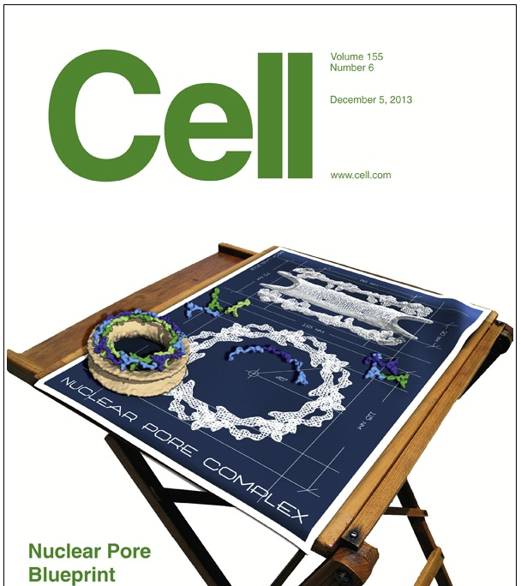
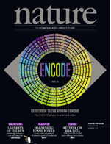
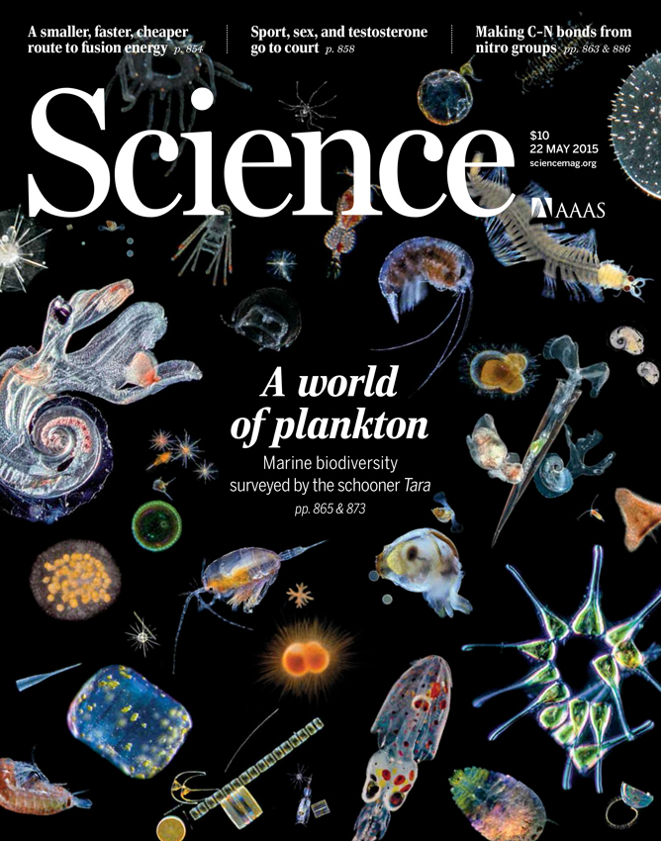


Scientific Excellence at EMBL
650 publications/year on average
40% of EMBL’s publications in the top 5% of journals in biochemistry, genetics and molecular biology
4 EMBL publications in the top 100 highest cited papers ever
Overall quality of its publications places EMBL in the top 10 research institutions worldwide
~30% of EMBL’s research group leaders hold ERC awards
Notes:
top 5% of journals in biochemistry, genetics and molecular biology according to the SCImago Journal Ranking (2014)
top 100 most highly cited papers: analysis by Van Noorden et al. “The top 100 papers”, featured in Nature, October 2014 (based on citation data from Thomson Reuters’ Science Citation Index)
top 10 research institutions according to the SCImago Institutions Ranking (2014), using the Q1 research quality indicator [indicates ratio of publications that an institution publishes in journals ranked in the first quartile (25%) in their categories as ordered by SCImago Journal Rank (SJRII) indicator]

Slide 10
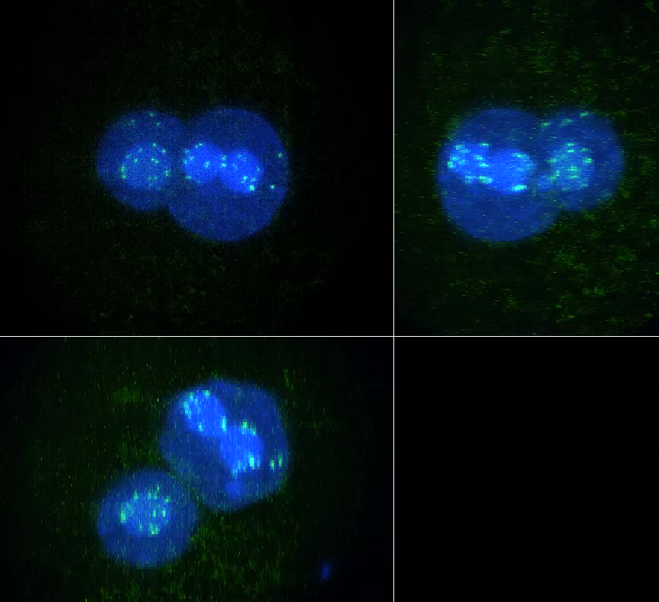
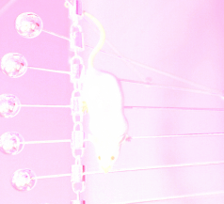
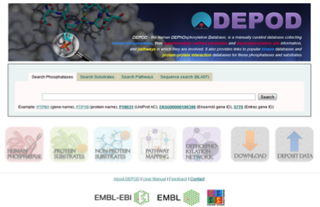
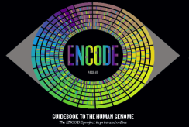
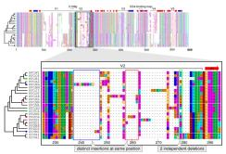
Research directions: 2012-2016 Programme
Imaging
Disease Models and Mechanisms
Computational Biology
Utilising Next Generation Sequencing
Notes:
EMBL’ research pursues a multidisciplinary and multiscale approach towards unravelling the principles and logic of the complex functional organisation that defines all biological systems, in both physiological and disease states. Its approach combines EMBL’s traditional strength in mechanistic studies and hypothesis-driven research – using real-time live imaging, complementary structural biology technologies at different scales and biochemical studies – with systems approaches employing ‘omics’ methods and computational biology.

Slide 11
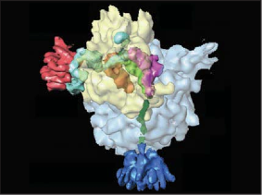
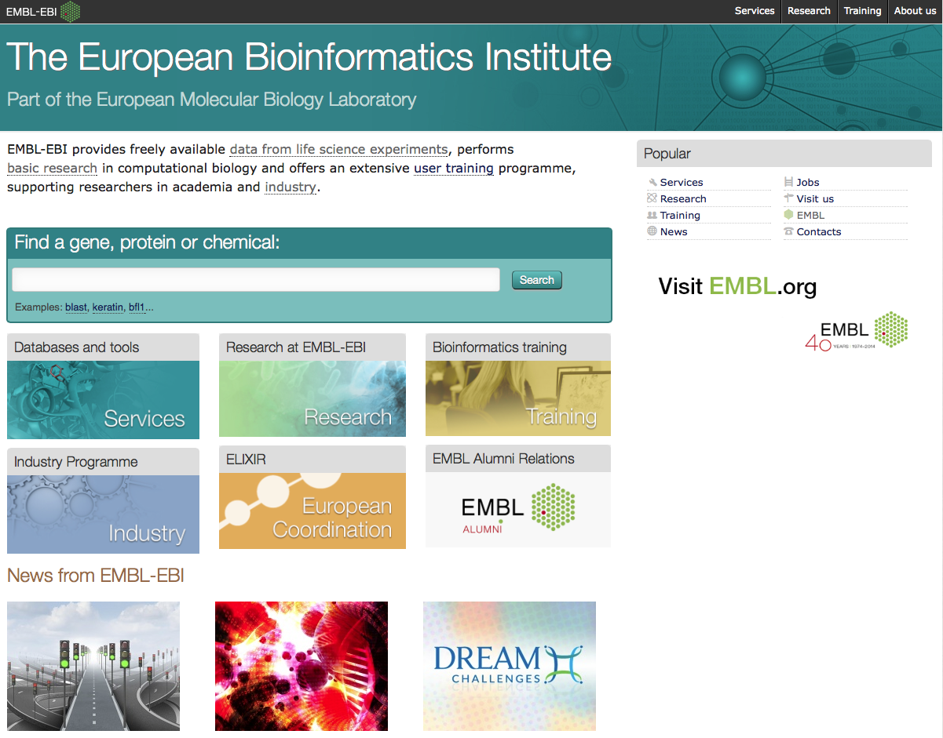
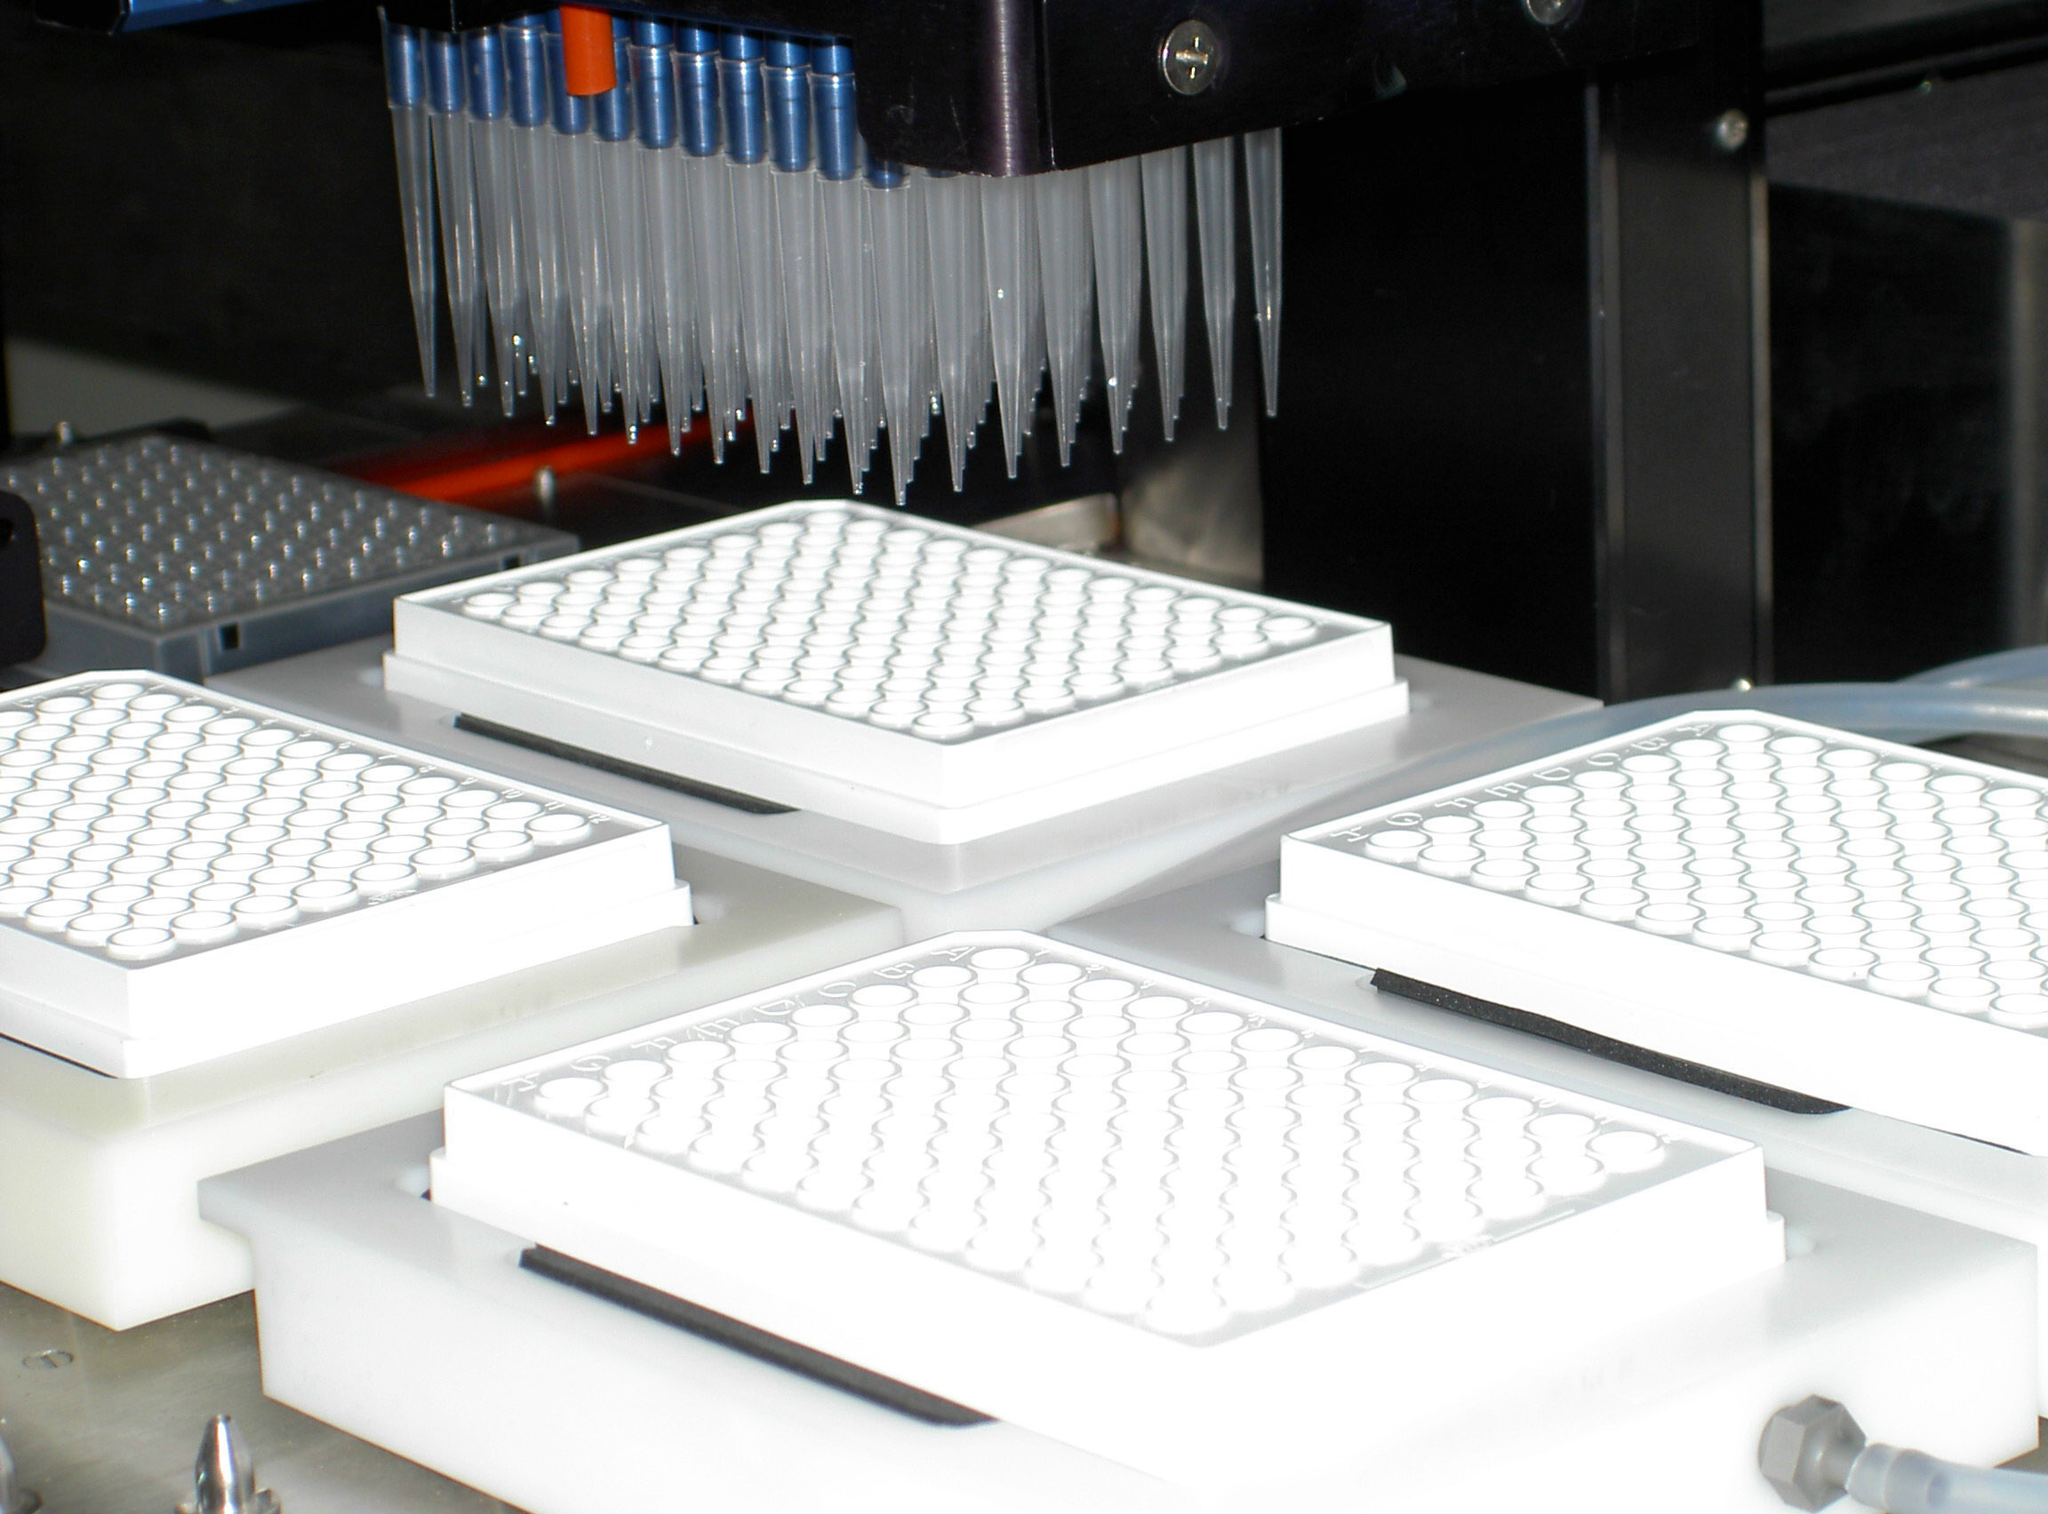
EMBL infrastructure and services
+ training
Structural Biology
~ 2,500 user visits per year
many users of complementary services
Bioinformatics at EMBL-EBI
> 11,000,000 web visits per day
Core Facilities
> 1,200 internal and external users per year
Notes:
EMBL operates unique world-leading research infrastructure and services that enable European researchers to achieve breakthroughs across many scientific disciplines. Each year, several thousand scientists gain access to cutting-edge technologies and expertise. To transfer this knowledge to our member states, EMBL also trains and enables users to install similar facilities at national institutions.

Slide 12
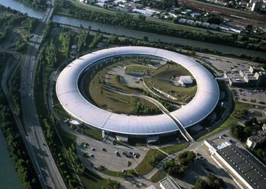
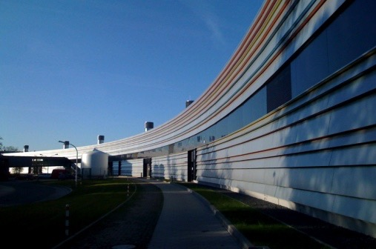


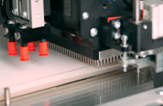
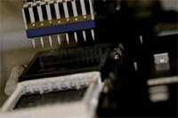
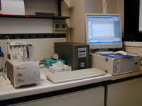
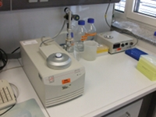
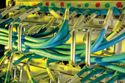



EMBL Services in Structural Biology
EMBL Grenoble at ESRF
5 MX & 1 SAXS
EMBL Hamburg at PETRAIII
2 MX & 1 SAXS
Beamlines are integrated into advanced facilities for
biological sample preparation, characterisation, crystallisation, X-ray data processing and evaluation
High-throughput
expression
High-throughput
crystallisation
Analysis of interactions
Sample preparation
& characterisation
High-throughput
crystallisation
Computational
facilities & software
Access to Neutron Sources
Deuteration Isotope Labelling Facility
Notes:
Together with the German Electron Synchrotron (DESY) in Hamburg and the European Synchrotron Radiation Facility (ESRF) in Grenoble, EMBL provides access to crucial enabling infrastructure and services for structural biology users from all over Europe. Through an integrated approach EMBL provides access to cutting-edge equipment and expertise covering the complete pipeline for structural biology studies, from sample preparation to data analysis.

Slide 13

Infrastructure: Data resources at EMBL-EBI
Genes, genomes & variation
European Nucleotide Archive
Ensembl 1000 Genomes
Ensembl Genomes
European Genome-phenome Archive
Metagenomics portal
Gene, protein & metabolite expression
ArrayExpress
Expression Atlas
Metabolights
PRIDE
Literature & ontologies
Europe PubMed Central
Gene Ontology
Experimental Factor Ontology
Proteins & protein families
InterPro
Pfam
UniProt
Molecular structures
Protein Data Bank in Europe
Electron Microscopy Data Bank
Chemical biology
ChEMBL
ChEBI
Reactions, interactions & pathways
Systems
IntAct Reactome
MetaboLights
BioModels
Enzyme Portal
BioSamples
Notes:
Through EMBL’s European Bioinformatics Institute (EMBL-EBI), the world’s most comprehensive source of biomolecular data, EMBL provides a broad community of commercial and academic researchers around the world with access to crucial biological data. This slide, which shows the core resources at the EBI, gives an idea of the range and diversity of data that can be accessed through EMBL bioinformatics resources.

Slide 14









EMBL Scientific Core Facilities
Flow Cytometry
Advanced Light Microscopy
Electron Microscopy
Protein Expression
and Purification
Proteomics
Transgenics (MR, HD)
(coming soon)
Genomics
Chemical Biology
Notes:
EMBL’s Core Facilities, operated mostly at the headquarters in Heidelberg, serve scientists’ technology needs and are a central component of EMBL’s research network. These facilities are heavily used by scientists throughout EMBL, and where capacity allows also by researchers from our member states and beyond. Institutions in member states frequently seek EMBL’s advice and guidance in setting up their own core facilities and services to enhance the efficiency and effectiveness of their scientific research.

Slide 15







Training at EMBL
EMBL International Center for Advanced Training
EICAT Partners
EMBL International
PhD Programme
EMBL Postdoctoral Programme
General Training and Development Programme
Internal
EMBL Courses
and Conferences
EMBL Visitors’
and Scholars’ Programme
European Learning Lab
for the Life Sciences
External
EMBL’s fixed-term contract system means we also constantly train
new research, service and administrative staff
15
Notes:
EMBL is a centre of excellence for advanced training and has helped launch the careers of several thousand life scientists. EMBL trains doctoral and postdoctoral fellows in world-leading programmes as well as young principal investigators (PIs) who, for the first time, independently lead research groups or service teams. In addition, EMBL provides development opportunities to all its staff, including through the The General Training and Development Programme (GTDP), open to all scientific and non-scientific personnel at EMBL. The GTDP offers a broad range of non-scientific vocational skills courses to train staff for their roles at EMBL as well as for future positions.
Internal training at EMBL is complemented by a number of external training activities/programmes, including Courses and Conferences, the Visitors’ Programme – which enables scientists and students from all over the world to benefit from unique knowledge and new technologies at the EMBL sites – and the European Learning Lab for the Life Sciences (ELLS), a science education programme for secondary-school teachers.

Slide 16



Technology Development
EMBL develops a broad spectrum of technology and instrumentation for life science research
Cross-fertilisation between research activities and technology development
Imaging technology
Software development
Synchrotron instrumentation
16
Notes:
EMBL has a long tradition and track record as a pioneer in the development of technology and instrumentation that drives progress in life science research at EMBL and beyond. Technology development is intertwined with and complementary to EMBL’s research and service activities. Engineers and technology developers are embedded in the EMBL Research Units and Core Facilities, and customise new instrumentation to researchers’ needs. Many of the instruments and tools developed at EMBL are of benefit to the entire scientific community and are made available to the users of EMBL’s services or through EMBL’s Technology Transfer activities..

Slide 17








Technology Transfer
The scientific community and society at large benefit from EMBL’s technology development and research discoveries
SPIM microscopy
Licensing
Discovery
or
Invention
Idea
Protection
Start-up company
> 170 patents granted
~ 2800 license & collaboration agreements
17 spin-outs
EMBL Technology Fund
Notes:
To facilitate the translation of basic research discoveries into practical applications and make new technologies and instruments developed at EMBL available to the broader scientific community and commercial partners, EMBL engages in technology transfer through its commercial subsidiary EMBLEM Technology Transfer GmbH. EMBLEM’s proactive technology transfer approach ensures the rapid commercial development of promising innovations while simultaneously securing the free dissemination of knowledge for basic research purposes.

Slide 18

Notes:
When employees leave EMBL to assume key positions in other institutes, the skills they have developed in the dynamic, interdisciplinary and international EMBL environment are exported to our member states. Over the years EMBL has produced nearly 7000 alumni, which act as ambassadors for the Laboratory and enrich the member states’ national systems with the experience and training gained at EMBL.
Over 80% of EMBL alumni take up positions in one of EMBL’s member states.

Slide 19







Integration of life science research in Europe
EMBL Partnerships
ESFRI-BMS projects
Science policy and strategy

Slide 20

What are the requirements for EMBL Partnerships?
Partnerships are funded nationally
Program only for EMBL member states
Critical mass
Scientific excellence & complementarity
Scientific interaction and common initiatives
Principles of good scientific practice and integrity
Adoption of aspects of the EMBL operational model:
  International recruitment
  Staff turnover
  Training
  Regular external review
20
Notes:
BENEFITS:
Increased international visibility
Internationalization of recruitment
EMBL partner institutes are highly attractive to talented young scientists from around the globe
Building state-of-the-art infrastructures in the Member States
Creating European and global research networks of excellence
Benefiting from EMBL’s help and expertise in scientific reviews, recruitments, setting up training programs etc.

Slide 21

What are some of the benefits for Partner Institutes?
  Increased international visibility
  Internationalization of recruitment
    EMBL partner institutes are highly attractive to talented young scientists from around the globe
  Building state-of-the-art infrastructures in the Member States
  Creating European and global research networks of excellence
  Benefiting from EMBL’s help and expertise in scientific reviews, recruitments, setting up training programs etc.

Slide 22
Summary - Benefits of membership
Scientists from EMBL Member States have better access to EMBL core facilities.
Member States have better access to synchrotron beamlines at EMBL in Hamburg and Grenoble.
Right to compete for PhD and Post doctoral positions, which are funded by EMBL.
Possibility to establish a joint PhD degree with a University in CZ.
The possibility to establish an exclusive partnership with EMBL, i.e. a close cooperative affiliation between EMBL and institution(s) in CZ.
EMBL provides to its Member States at their request extensive advice in setting up world-class national research infrastructure.
Excellent prospects for networking of national molecular biology scientists on the European level and beyond through contacts established within the EMBL network.
Access to technology transfer knowhow (through EMBLEM). Member States have access to the EMBL’s early stage investment fund to support biotechnology start-ups
Right to vote in the EMBL Council, the main decision-making body, and by that co-deciding on all the issues concerning EMBL and its outstations, including the EMBL scientific programme and its budget.

Slide 23





Highlights: EMBL links to the Czech Republic
Memorandums of Understanding on scientific cooperation with CEITEC (2012) and BIOCEV (2013) with numerous activities since:
  Several extensive scientific visits to EMBL, study visits of managers and administrators from both partners → collaborations have taken off!!
  Joint applications for H2020 grants – recent success “twinning grant” with CEITEC;
  Participation in scientific reviews of the institutions;
  EMBO workshop with EMBL senior scientific staff at CEITEC in 2015
Yearly course on functional genomics at the Charles University and University of South Bohemia – ongoing since 2012;
EMBL-EBI Bioinformatics workshop at the National Technical Library in 2014;
Cooperation with IMG in H2020 gender equality call – 2015;

Slide 24


Highlights: EMBL links to the Czech Republic
Since the beginning of the membership we have also noticed:
  Increased use of the Core Facility Services in Heidelberg, structural biology services in GR and HH, participation in EMBL courses and conferences;
Current good cooperation is reflected also in:
  10 joint publications and 14 active joint grants with CZ institutions in 2014
Upcoming activities:
  Negotiation of the Joint PhD Degree Award with the Charles University;
  Cooperation in bioinformatics masters course with the Faculty of Sciences (Charles University);
→ EMBL has been connecting to a variety of scientific actors across the Czech Republic in different fields and with different activities

