Slide 1

Teaching profession today and tomorrow
Kaiserštejnský Palace
Andreas Schleicher

Slide 2


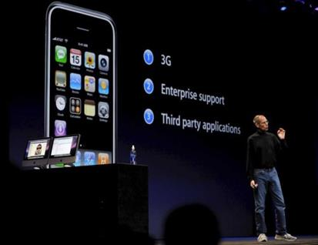
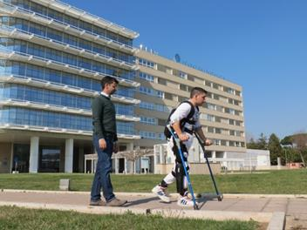
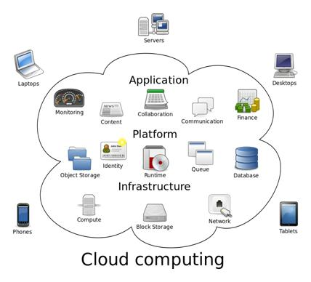
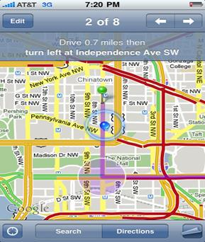




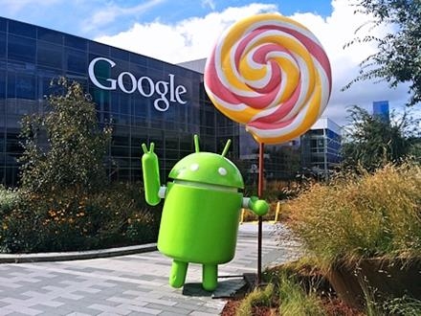
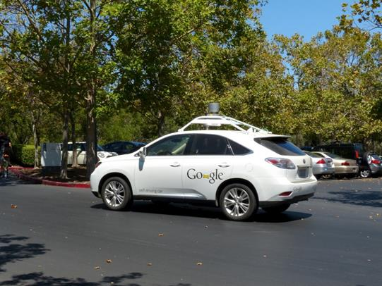
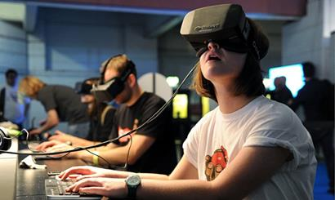
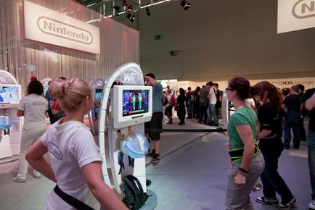



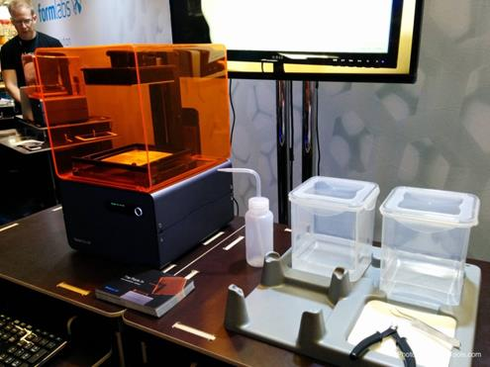
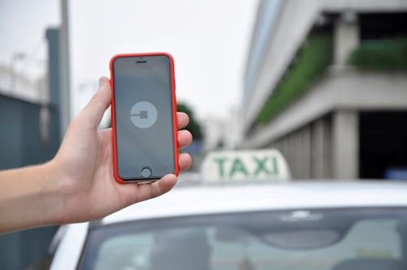
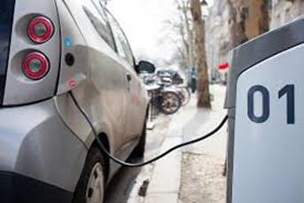

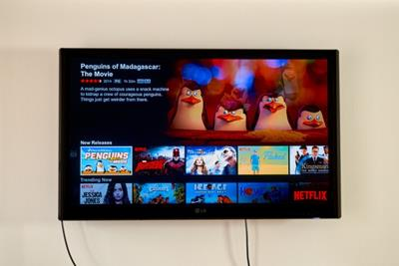

Trends in science performance (PISA)
570
550
Student performance
Lev5
530
Level 4
Level 3
510
Level 2
490
Level 1
470
Below Level 1
450
2006
2009
2012
2015
Notes:
We did our last PISA assessment of learning outcomes in science in 2006, and it was a quite different world then.
It is hard to imagine but we did not have the iphone then. Twitter was still a sound, Skype for most people was a typographical error in those times, the amazon was still a river, there was no android, no video streaming.
But science learning outcomes in the industrialised world remained entirely flat during those years.
And the world moved on, streetmaps became dynamic,
cars became electric and started to drive automatically, drones started to fly, and crowdfunding hugely amplified the potential of each of us individually and of us collectively.
But again, this did not translate into improved learning outcomes.
And in just the last few years, so many things have happened, virtual reality brought the whole world to each of us in real time, 3D printers can produce right where we are, robotics is changing the lives of people, or think about big data, the cloud, biogenetics and our capacity to affect life as such.
But science performance of students remained unfazed by all of this.
When you see that, you might be tempted to drop the idea of improving education, as an agenda that is too big, too complex and too politically charged and too entrenched in vested interests to warrant real progress.
But dont give up yet, the PISA data also show some amazing success stories.

Slide 3



Trends in science performance
570
550
Lev5
530
Level 4
Level 3
510
Level 2
490
Level 1
470
Below Level 1
450
Notes:
All countries are included and can be selected by selecting „select data“ and use the filter to choose the country of interest. Missing data/years have to be deleted.
The range of the axis may need to be adjusted for each country.

Slide 4
Money is necessary but not sufficient
Spending per student from the age of 6 to 15 and science performance
Figure II.6.2

Slide 5


Learning time and science performance (PISA)
Figure II.6.23
Productivity
Learning out of school
Time in school

Slide 6
Changing education can be like moving graveyards
The status quo has many protectors
  Everyone supports reform – except for their own children
  Even those who promote reforms often change their mind when they understand what change entails for them
The frogs rarely clear the swamp
  The loss of privilege is pervasive because of the extent of vested interests
Asymmetry of costs and benefits of educational reform
  Costs are certain and immediate, benefits are uncertain and long-term
Lack of supportive ecosystems
  Lack of an ‘education industry’ that pushes innovation and absorbs risks
  A research sector that is often disengaged from the real needs of real classrooms
You can lose an election but you don’t win one over education
  Complexity and length of reform trajectory that extend electoral cycles
  A substantial gap between the time when the cost of reform is incurred, and the time when benefits materialise

Slide 7
When fast gets really fast, being slow to adapt makes education really slow
Industrial systems
World class systems
Student inclusion
Some students learn at high levels (sorting)
All students need to learn at high levels
Routine cognitive skills
Complex ways of thinking, complex ways of doing, collective capacity
Curriculum, instruction and assessment
Standardisation and compliance
High-level professional knowledge workers
Teacher education
‘Tayloristic’, hierarchical
Flat, collegial
Work organisation
Accountability
Primarily to authorities
Primarily to peers and stakeholders
Notes:
I want to conclude with what we have learned about successful reform trajectories
In the past when you only needed a small slice of well-educated people it was efficient for governments to invest a large sum in a small elite to lead the country. But the social and economic cost of low educational performance has risen substantially and all young people now need to leave school with strong foundation skills.
When you could still assume that what you learn in school will last for a lifetime, teaching content and routine cognitive skills was at the centre of education. Today, where you can access content on Google, where routine cognitive skills are being digitised or outsourced, and where jobs are changing rapidly, the focus is on enabling people to become lifelong learners, to manage complex ways of thinking and complex ways of working that computers cannot take over easily.
In the past, teachers had sometimes only a few years more education than the students they taught. When teacher quality is so low, governments tend to tell their teachers exactly what to do and exactly how they want it done and they tend to use Tayloristic methods of administrative control and accountability to get the results they want. Today the challenge is to make teaching a profession of high-level knowledge workers.
But such people will not work in schools organised as Tayloristic workplaces using administrative forms of accountability and bureaucratic command and control systems to direct their work.
To attract the people they need, successful education systems have transformed the form of work organisation in their schools to a professional form of work organisation in which professional norms of control complement bureaucratic and administrative forms of control.

Slide 8

Some learn at high levels

Slide 9

All learn at high levels

Slide 10
Poverty is not destiny –
Learning outcomes by international deciles of the PISA index of economic, social and cultural status (ESCS)
Figure I.6.7
OECD median student
% of students in the bottom international deciles of ESCS

Slide 11
Aligning resources with needs
Average class size in <9th grade>, by quarter of school socio-economic profile
Average class size
Schools by social background

Slide 12
Aligning resources with needs
Science teachers without a university major in science, by school socio-economic profile (OECD Average)
% science teachers without university major in science
Schools by social background

Slide 13
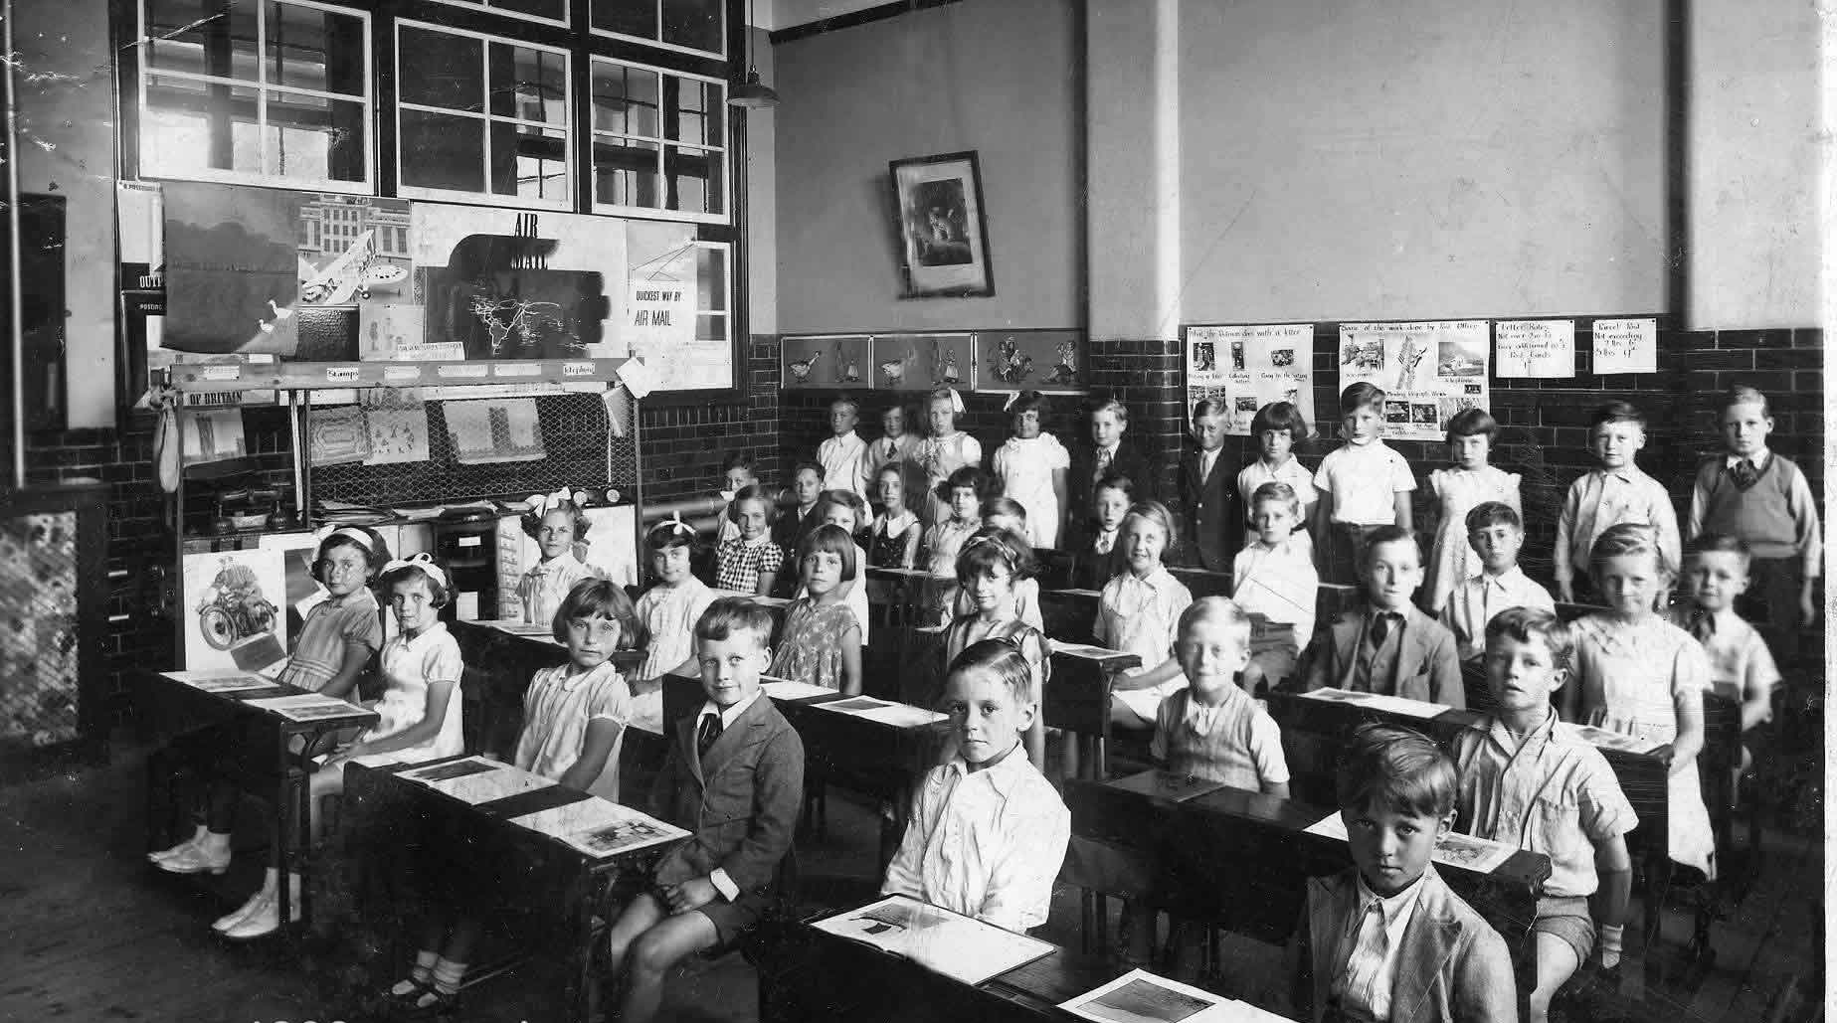
Reproducing knowledge

Slide 14


Creating knowledge
Think for yourself and work with others

Slide 15
The rise of the global middle class
Within the next decade the majority of the world population will consist of the middle class
Estimates of the size of the global middle class, percentage of the world population (left axis) and headcount (right axis)
Source: Kharas, H. (2017), The unprecedented expansion of the global middle class, an update, https://www.brookings.edu/wp-content/uploads/2017/02/global_20170228_global-middle-class.pdf. Kharas, H. (2010), The emerging middle class in developing countries, https://www.oecd.org/dev/44457738.pdf.
Figure 1.2

Slide 16
Growing unequal
Income gaps continues to grow
Trends in real household incomes by percentile, OECD average, 1985-2015
Index 1985 = 1
Source: OECD (2018), A Broken Social Elevator? How to Promote Social Mobility, https://doi.org/10.1787/9789264301085-en.
Figure 2.1
Notes:
Note: Income refers to real household disposable income. OECD average refers to the unweighted average of the 17 OECD countries for which data are available: Canada, Denmark, Finland, France, Germany, Greece, Israel, Italy, Japan, Luxembourg, Mexico, the Netherlands, New Zealand, Norway, Sweden, the United Kingdom and the United States. Some data points have been interpolated or use the value from the closest available year.

Slide 17
More people on the move
Estimates of international migrant stock by region of destination, 1990-2017
Source: United Nations (2017), "International migrant stock: The 2017 revision" (database), www.un.org/en/development/desa/population/migration/data/.
Figure 1.5
Notes:
Note: Northern America includes Bermuda, Canada, Greenland, Saint Pierre and Miquelon, USA and Mexico.

Slide 18
Rising volatility
Household savings and debt
Household savings (% of disposable income, left axis) and household debt (% of disposable income, right axis),
OECD average, 1970-2016
Source: OECD (2018), OECD National Accounts Statistics (database), https://stats.oecd.org/.
Figure 3.9
Notes:
Note: OECD average refers to the average of 32 countries: Australia, Austria, Belgium, Canada, Chile, Czech Republic, Germany, Denmark, Spain, Estonia, Finland, France, United Kingdom, Greece, Hungary, Ireland, Italy, Japan, Korea, Luxemburg, Latvia, Mexico, Netherlands, Norway, New Zealand, Poland, Portugal, Slovak Republic, Slovenia, Sweden and the United States

Slide 19
Access to Access
Number of mobile broadband subscriptions per 100 inhabitants, OECD average, 2009-2017
Source: OECD (2018), "Mobile broadband subscriptions" (indicator), https://doi.org/10.1787/1277ddc6-en.
Figure 5.1

Slide 20
The growth in AI technologies…
…pushes us to think harder about what makes us truly human
Number of patents in artificial intelligence technologies, 1991-2015
Source: OECD (2017), OECD Science, Technology and Industry Scoreboard 2017: The digital transformation, http://dx.doi.org/10.1787/9789264268821-en.
Figure 1.10
Notes:
Note: Data refer to the number of IP5 patent families in artificial intelligence (AI), by filing date and inventor's country, using fractional counts. AI refers to the "Human interface" and "Cognition and meaning understanding" categories in the ICT patent taxonomy as described in Inaba and Squicciarini (2017). 2014 and 2015 figures are estimated based on available data for those years.

Slide 21

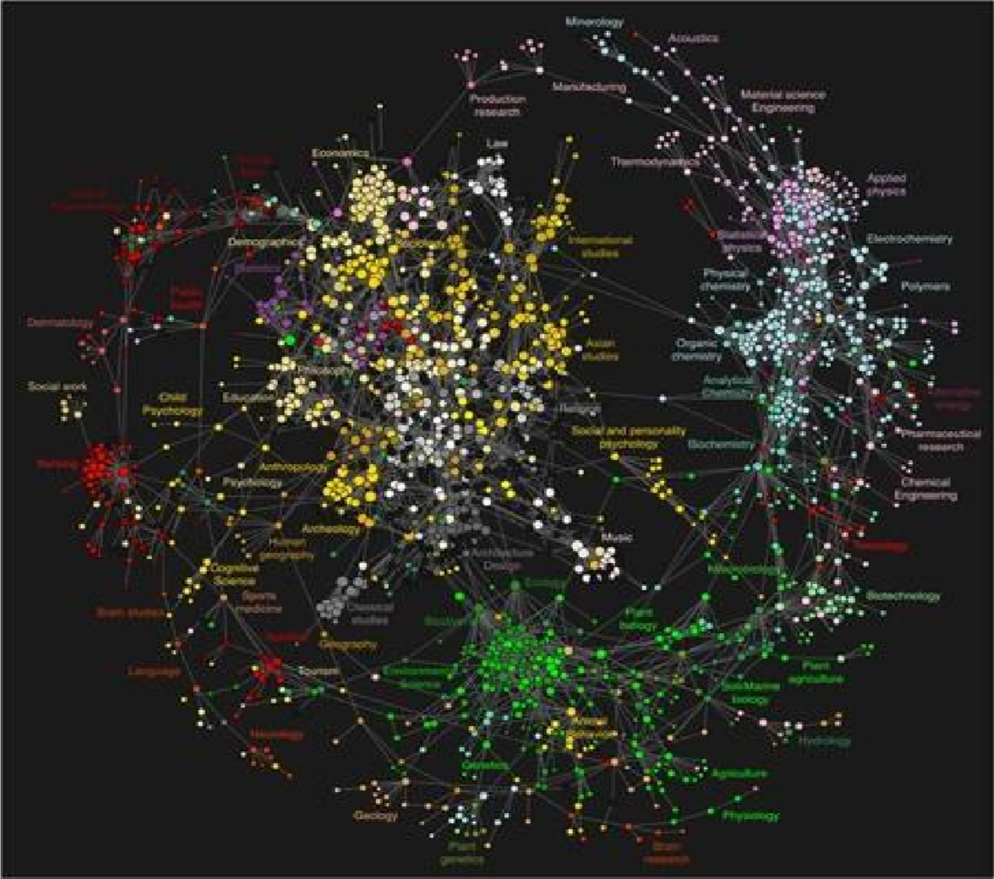
Digitalisation
Particularizing
Disempowering
Democratizing
Concentrating
Homogenizing
Empowering

Slide 22
TWO EFFECTS OF DIGITALISATION
Tasks
Tasks
Tasks with
Tasks with
without
without
use of ICT
use of ICT
use of ICT
use of ICT

Slide 23
TWO EFFECTS OF DIGITALISATION
(C)
Non routine tasks,
Non routine tasks,
Non routine tasks,
Non routine tasks,
Low use of ICT
High use of ICT
High use of ICT
Low use of ICT
Routine tasks,
Routine tasks,
Low use of ICT
High use of ICT
Routine tasks,
Routine tasks,
Low use of ICT
High use of ICT

Slide 24
15-year-olds feeling bad if not connected to the Internet (PISA)

Slide 25
Students are using more time online outside school on a typical school day (PISA)
Figure III.13.3
Percentage of High Internet Users (spending 2 to 6 hours on line per day), during weekdays

Slide 26
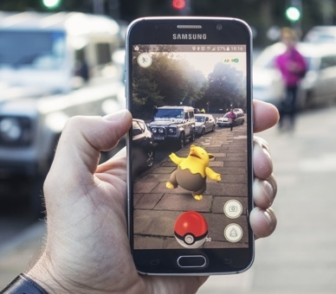
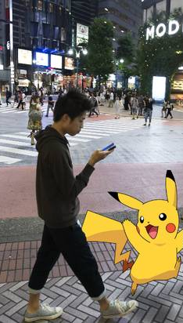
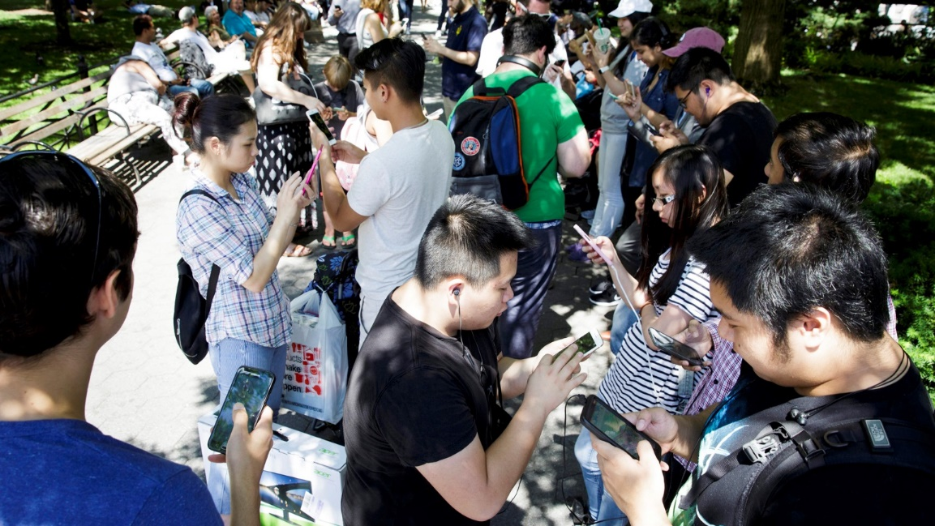
Digitalisation
Particularizing
Disempowering
Democratizing
Concentrating
Homogenizing
Empowering
The post-truth world where reality becomes fungible
Virality seems privileged over quality
in the distribution of information
Truth and fact are losing currency
Scarcity of attention and abundance of information
Algorithms sort us into groups of like-minded individuals create echo chambers that amplify our views, leave us uninformed of opposing arguments, and polarise our societies

Slide 27
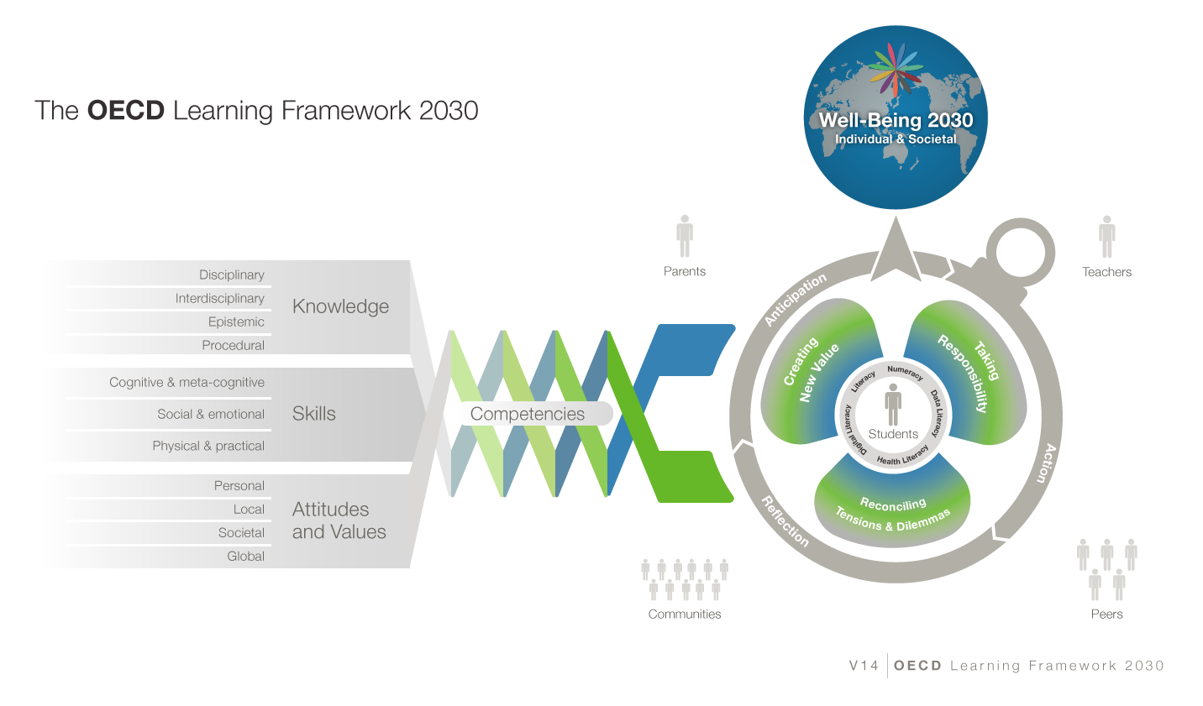
The future will be about pairing the artificial intelligence of computers with the cognitive, social and emotional skills and values of humans

Slide 28
Some lessons
Rigor, focus and coherence
Remain true to the disciplines
  but aim at interdisciplinary learning and the capacity of students to see problems through multiple lenses
  Balance knowledge of disciplines and knowledge about disciplines
Focus on areas with the highest transfer value
  Requiring a theory of action for how this transfer value occurs
Authenticity
  Thematic, problem-based, project-based, co-creation in conversation
Some things are caught not taught
  Immersive learning propositions

Slide 29

Prescription

Slide 30

Ownership of professional practice
Powerful learning environments are constantly creating synergies and finding new ways to enhance professional, social and cultural capital with others. They do that with families and communities, with higher education, with other schools and learning environments, and with businesses.

Slide 31
Who decides?
Percentage of decisions taken at each level of government in public lower secondary education (2017)

Slide 32
Making teaching not just financially, but intellectually more attractive
Public confidence in profession and professionals
Professional preparation and learning
Collective ownership of professional practice
Professional responsibility in the name of the profession and accountability towards the profession
Decisions made in accordance with the body of knowledge o the profession

Slide 33

Policy levers to teacher professionalism
Mean mathematics performance, by school location, after accounting for socio-economic status
33
33
Fig II.3.3
Policy levers to teacher professionalism
Autonomy: Teachers’ decision-making power over their work (teaching content, course offerings, discipline practices)
Teacher
professionalism
Peer networks: Opportunities for exchange and support needed to maintain high standards of teaching (participation in induction, mentoring, networks, feedback from direct observations)
Knowledge base for teaching (initial education and incentives for professional development)
Notes:
There are different models of teacher professionalism across the TALIS systems, these figures present an example of the five most frequent models:
High peer networks/low autonomy
High autonomy
Knowledge emphasis
Balance domains/high support for professionalism
Balance domains/ low support for professionalism

Slide 34
TALIS Teacher professionalisation index
Mean mathematics performance, by school location, after accounting for socio-economic status
TALIS Teacher professionalism index
34
Fig II.3.3
Notes:
The figure presents and overview of teacher professionalism looks like across TALIS systems, by plotting the teacher professionalism index. The index measures the extent to which education systems support teachers’ professionalism in each of TP domains. Each of the domains of teacher professionalism is scaled from 0 to 5, with 5 representing a theoretical maximum where all practices within the domain are observed. The overall index of teacher professionalism adds up values on the three domains, with values ranging from a theoretical minimum of 0 to a possible maximum of 15. In reality, as the figure shows, most teachers find themselves in environments where these practices are partially observed.

Slide 35
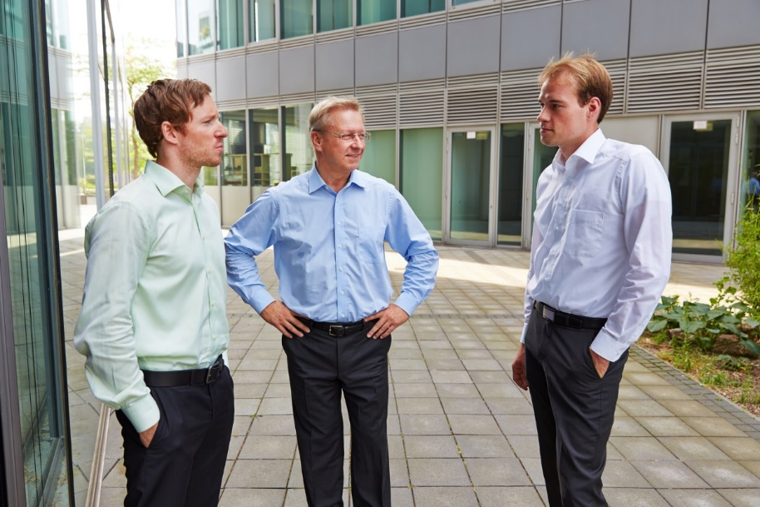






Teacher professional collaboration
Percentage of lower secondary teachers who report doing the following activities at least once per month
(OECD countries)
Exchange and co-ordination
Notes:
So if collaboration is important, how frequently do teachers engage in it?
The pictures is actually mixed. When it comes to informal exchange and co-ordination, teachers are generally very active.
And Alberta, here marked in red, is no exception to this.
However, the kind of deep professional collaboration I referred to in the preceding chart is actually quite rare, as you can see on the right panel. Only one in 5 teachers pursues team teaching, that you saw closely related to job satisfaction, at least one per month. In countries such as Japan, Denmark or Italy it is a bit more common, but still not as frequent as you hope it might be. And the picture is similar for collaborative professional development. Even in Alberta, which together with Singapore, Australia and Israel does best on this you still find only a third of teachers doing this at least once per months. And least frequent is classroom observation that you also saw closely related to job satisfaction.

Slide 36
Teachers’ self-efficacy and professional collaboration
Less
frequently
More
frequently
Notes:
Here is some data on this.
Teachers who teach more often jointly as a team consistently report higher levels of job satisfaction.
The same is true for observing other teachers classes
Or engaging in joint activities across different classes
Or to take part in collaborative professional learning

Slide 37

Student-teacher ratios and class size
Figure II.6.14
High student-teacher ratios and small class sizes
OECD average
OECD
average
Low student-teacher ratios and large class sizes

Slide 38
Teachers’ job satisfaction and class size
Notes:
-TALIS data indicates that the type of students who are in a class has the largest association with the teacher’s self-efficacy and job satisfaction.
-As seen in the figure, class size has minimum effect on teachers’ job satisfaction compared to the stronger influence of teaching students with behavioural problems (Next slide).
- What this also tells us is that teachers need to be better prepared and supported to teach in classes with students who have different achievement levels, special needs or behavioural problems.

Slide 39
Teacher job satisfaction and professionalism
Fig II.3.3
Perceptions of
teachers’ status
Satisfaction with the profession
Satisfaction with the work environment
Teachers’
self-efficacy
Notes:
The figure shows teacher’s predicted percentile in the distribution of all teachers, estimated by his or her overall score on the teacher professionalism index. The figure indicates where in the distribution of all teachers a given teacher would be expected to rank if she benefited from only one support, compared to those benefiting from five or ten best practices. As the figure shows, teachers with a value on the overall index of only one are expected to fall in the bottom third of all teachers in terms of their perceived status and self-efficacy and their satisfaction with their profession and work environment. In contrast, teachers with a value of five on the overall professionalism index are in the 40-51st percentile of all teachers in terms of all outcomes. At the top end of the spectrum, teachers with values of ten on the overall index, which corresponds to benefiting from two-thirds of the identified
In concrete terms, it appears that gains in support for teacher professionalism matter more at the lower end of the spectrum, such that implementing a few additional best practices matters more for teachers’ perceptions of status and self-efficacy and satisfaction with profession and work environment if they are not benefiting from any. At the top end, additional best practices do not have the same additional effect on teachers’ perceptions and satisfaction. best practices, are likely to rank in the top half of the distribution of all teachers.
In terms of variations across teachers’ perceptions and satisfaction, the analysis finds that teacher professionalism is least associated with teachers’ beliefs about the status of teaching in society, and more strongly linked to their perceptions of their own teaching and their satisfaction. The status outcome specifically asks teachers to what extent they believe that teaching is a valued profession in society, which may reflect larger structures of educational requirements and pay than the other three outcomes, which are more personal perceptions of satisfaction and teaching abilities. Nonetheless, we do find that higher values on the knowledge base and peer networks indices are both positively associated with perceived status.
A careful look at the domains of teacher professionalism (TP) reveals different patterns of relationships between the different TP domains and teacher outcomes. IN particular it shows particularly the importance knowledge base and peer networks.

Slide 40


Teachers perception of the value of teaching
Fig II.3.3
Percentage of lower secondary teachers who "agree" or "strongly agree" that teaching profession is a valued profession in society
Notes:
Figure 7.3

Slide 41
Countries where teachers believe their profession is valued show higher levels of excellence in learning outcomes (PISA)
41
Relationship between lower secondary teachers' views on the value of their profession in society and the country’s share of top mathematics performers in PISA 2012
Notes:
New graph for the PPT

Slide 42


Teachers’ skills
Numeracy test scores of tertiary graduates and teachers
Numeracy score
Notes:
Based on PIAAC, the blue bar shows the middle half of the distribution of numeracy skills of 16-64 year-old tertiary graduates (the end points are the 25th and 75th percentiles of the test scores) and the red segment shows the average nueracy scores of 16-64 year-old teachers (with a 95% confidence interval).
The results show that, among countries with comparable data, there is no country where teachers are in the top third of proficiency in these skills among all college-educated workers; and there is no country where they are among the bottom third of college graduates in these skills. In fact, teachers’ skills in numeracy, literacy and problem solving tend to be similar to those of the average university educated worker. There are just a few exceptions to this general trend: in Japan and Finland, for example, the average teacher has better numeracy skills than the average college graduate while in the Czech Republic, Denmark, Estonia, the Slovak Republic and Sweden, the reverse is true.
There is another way of looking at this. While, in each country, teachers tend to score similarly to college graduates on the numeracy test, the numeracy skills of the workforce as a whole differ substantially across countries. Consequently, the numeracy skills of teachers vary across countries too: teachers in Japan and Finland come out on top, followed by their Flemish (Belgium), German, Norwegian and Dutch counterparts. Teachers in Estonia, Italy, Poland and the United States come out at the bottom.

Slide 43
Teachers’ skills
Numeracy test scores of tertiary graduates and teachers
Numeracy skills of teachers
Numeracy score
Notes:
Based on PIAAC, the blue bar shows the middle half of the distribution of numeracy skills of 16-64 year-old tertiary graduates (the end points are the 25th and 75th percentiles of the test scores) and the red segment shows the average nueracy scores of 16-64 year-old teachers (with a 95% confidence interval).
The results show that, among countries with comparable data, there is no country where teachers are in the top third of proficiency in these skills among all college-educated workers; and there is no country where they are among the bottom third of college graduates in these skills. In fact, teachers’ skills in numeracy, literacy and problem solving tend to be similar to those of the average university educated worker. There are just a few exceptions to this general trend: in Japan and Finland, for example, the average teacher has better numeracy skills than the average college graduate while in the Czech Republic, Denmark, Estonia, the Slovak Republic and Sweden, the reverse is true.
There is another way of looking at this. While, in each country, teachers tend to score similarly to college graduates on the numeracy test, the numeracy skills of the workforce as a whole differ substantially across countries. Consequently, the numeracy skills of teachers vary across countries too: teachers in Japan and Finland come out on top, followed by their Flemish (Belgium), German, Norwegian and Dutch counterparts. Teachers in Estonia, Italy, Poland and the United States come out at the bottom.

Slide 44

The past was divided
Teachers and content divided by subjects and student destinations
Schools designed to keep students inside, and the rest of the world outside

Slide 45

The future is integrated
Integrated: Emphasising integration of subjects, integration of students and integration of learning contexts
Connected: with real-world contexts, and permeable to the rich resources in the community
Less subject-based, more project-based

Slide 46
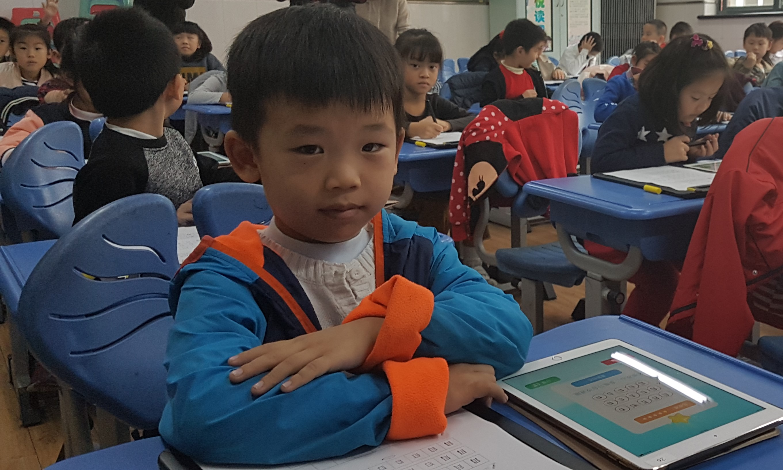

Slide 47
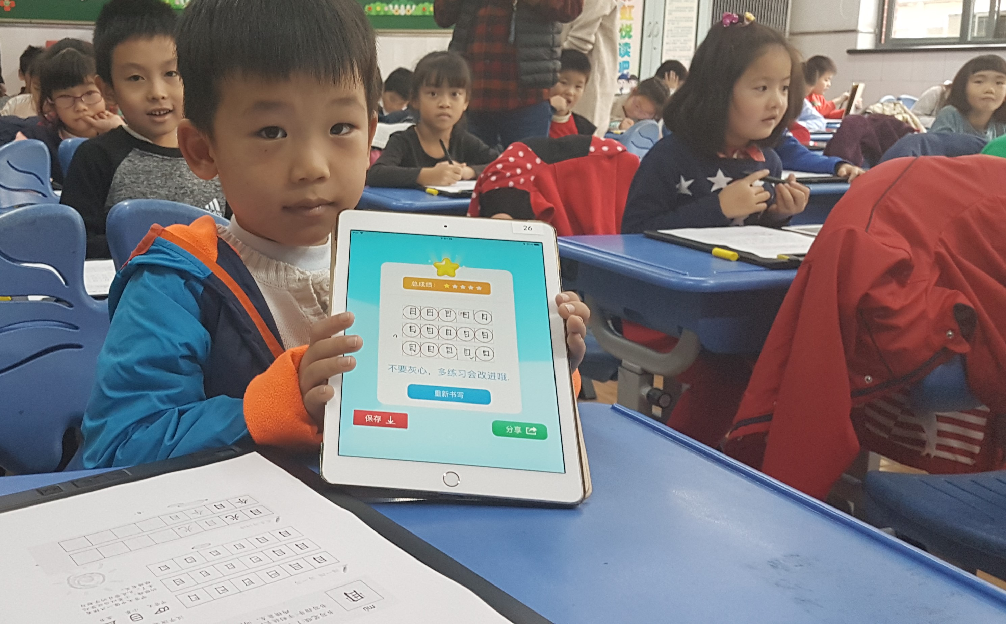

Slide 48
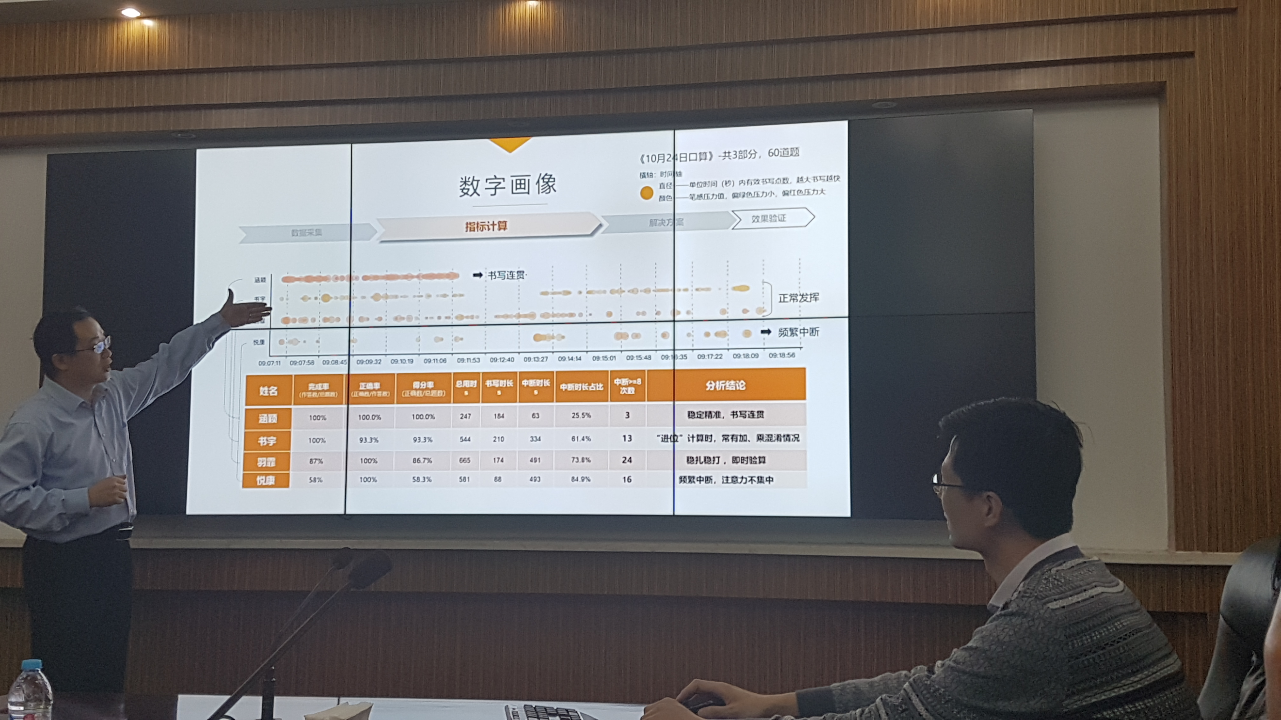

Slide 49

Bureaucratic Look-up

Slide 50

Devolved Look-outward

Slide 51
Parents’ interest in their child's activities at school and well-being (average)
More likely
Students who say their parents are interested in their school activities are…
As likely
Less likely

Slide 52

Standardisation and Conformity
Standardisation and compliance lead students to be educated in batches of age, following the same standard curriculum, all assessed at the same time.

Slide 53

Ingenious
Building instruction from student passions and capacities, helping students personalise their learning and assessment in ways that foster engagement and talents.

Slide 54

Mean mathematics performance, by school location, after accounting for socio-economic status
What do teachers say about innovation at school?
54
Fig II.3.3
Yes
No
%
If I am more innovative in my teaching
I will be rewarded (country average)
Notes:
When we looked at this more closely in 2008, many teachers talked about schools as rather innovation-hostile environments. For example, just a quarter of teachers said that if they were more innovative in their teaching, they would be rewarded, and this is not just about money, we looked at any form of recognition. The figures are particularly low in Belgium, Ireland, Denmark and Australia.
A higher percentage of teachers, though, said that innovative practices would be considered in appraisal and feedback, though you would really want to see this figure to be closer to 100%.

Slide 55

Ideosyncratic policy

Slide 56

Alignment of policies

Slide 57
Making change happen
Knowledge is only as valuable as our capacity to act on it,
and the road of educational reform is littered with good ideas that were poorly implemented

Slide 58
The real obstacle to education reform is not conservative followers but conservative leaders
be transparent with teachers and school leaders about
where reform is heading and what it means for them
be aware of how organisational policies and practices
can either facilitate or inhibit transformation
tackle institutional structures that are built around the interests and habits of educators and administrators rather than learners
recognise emerging trends and patterns and see how these might benefit or obstruct the goals of change
use knowledge about what motivates people to convince others to support change
use understanding of power and influence to build the alliances and coalitions needed to get things done
help rules become practice, and good practice to become culture

Slide 59
The real obstacle to education reform is not conservative followers but conservative leaders
Programmes do not scale; it is culture that scales, and culture is the hallmark of effective leadership.
Culture is about system learning, system-wide innovation, and purposeful collaboration

Slide 60
Making change happen
Setting the direction
Engaging the profession
Building capacity
Looking outward
People are more likely to accept changes that are not solely in their own interests if they understand the reasons for these changes and can see the role they should play within the broad strategy.

Slide 61
Making change happen
Setting the direction
Engaging the profession
Building capacity
Looking outward
People are more likely to accept changes that are not solely in their own interests if they understand the reasons for these changes and can see the role they should play within the broad strategy.
Educational leaders are rarely successful with reform unless they build a shared understanding and collective ownership for change, and unless they build capacity and create the right policy climate, with accountability measures designed to encourage innovation rather than compliance

Slide 62
Making change happen
Setting the direction
Engaging the profession
Building capacity
Looking outward
People are more likely to accept changes that are not solely in their own interests if they understand the reasons for these changes and can see the role they should play within the broad strategy.
Educational leaders are rarely successful with reform unless they build a shared understanding and collective ownership for change, and unless they build capacity and create the right policy climate, with accountability measures designed to encourage innovation rather than compliance
Often the resource implications of reform are underestimated in scope, nature and timing. The main shortcoming is often not a lack of financial resources, but a dearth of human capacity at every level of the system.

Slide 63
Making change happen
Setting the direction
Engaging the profession
Building capacity
Looking outward
People are more likely to accept changes that are not solely in their own interests if they understand the reasons for these changes and can see the role they should play within the broad strategy.
Educational leaders are rarely successful with reform unless they build a shared understanding and collective ownership for change, and unless they build capacity and create the right policy climate, with accountability measures designed to encourage innovation rather than compliance
Often the resource implications of reform are underestimated in scope, nature and timing. The main shortcoming is often not a lack of financial resources, but a dearth of human capacity at every level of the system.
School systems that feel threatened by alternative ways of thinking get trapped in old practice. The ones that progress are those that are open to the world and ready to learn from and with the world’s education leaders.

Slide 64

In conclusion
oe.cd/WorldClass
Andreas.Schleicher@OECD.org
Universal high quality education is an attainable goal, and our task is not to make the impossible possible, but to make the possible attainable. It is entirely within our means to deliver a future for millions of learners who currently don’t have one

Slide 65

Thank you
  Find out more about our work at www.oecd.org/pisa
    All publications
    The complete micro-level database
  Email: Andreas.Schleicher@OECD.org
  Twitter: SchleicherOECD
  Wechat: AndreasSchleicher
  and remember:
  Without data, you are just another person with an opinion

