Slide 1
SeARch engine
Automatic Recognition; Access vs Admission
25 March 2021
Katrien Bardoel
International Recognition Dpt.

Slide 2
What is Automatic Recognition?
How is it implemented? (4 models)
Tools to support admissions officers

Slide 3
What is automatic recognition?
“Automatic recognition of a degree leads to the automatic right of an applicant holding a qualification of a certain level to be considered for entry to the labour market or a programme of further study in the next level in any other EHEA-country (access)“ - 2008 EHEA pathfinder group on AR
Right to access ≠ (always) admission
Recognition of foreign qualifications is subject to LRC

Slide 4
Main principle LRC: Substantial Difference
“Foreign qualifications should be recognized unless there is a substantial difference”
Recognition always in light of purpose
Look at 5 elements of qualification
Quality 4. Profile
Level 5. Learning Outcomes
Workload

Slide 5
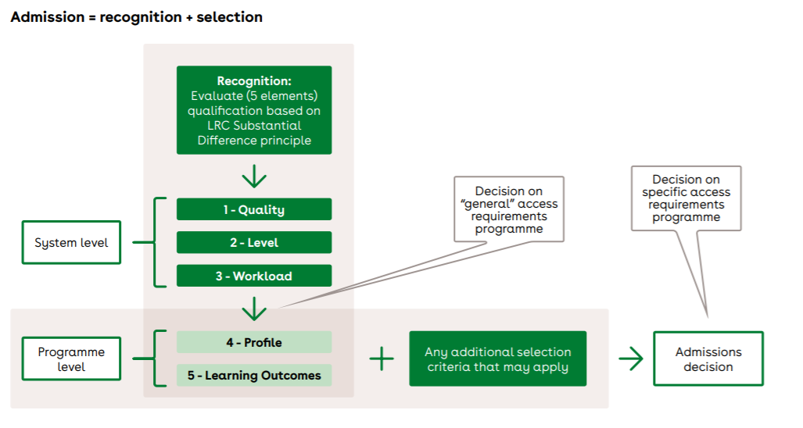
Automatic Recognition = on system level
(a bachelor = a bachelor)
Automatic Recognition is LRC – Substantial Differences

Slide 6
Questions?
Read more:
The Triangle of Automatic Recognition | Nuffic

Slide 7
4 Models for Automatic Recognition
1. Legal bilateral and multilateral agreements (Benelux agreement);
2. A legally binding unilateral list of countries and qualifications (Portugal);
3. Non-legal bilateral and multilateral agreements (Nordic-Baltic manual);
4. ‘De facto’ automatic recognition (Nuffic education systems)

Slide 8
Different models of automatic recognition can be applied simultaneously;
Implementation of the LRC, the three-cycle system of higher education with reference to the EQF/EHEA Frameworks and a QA system based on the ESG are important criteria for all forms automatic recognition.

Slide 9
Questions?
Read more:
a-short-path-to-automatic-recognition-4-models (nuffic.nl)

Slide 10
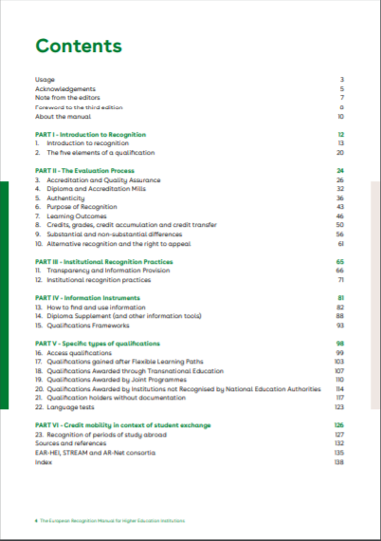
Tools for admissions officers
EAR-HEI
Practical translation LRC
Support the implementation of elements of AR

Slide 11
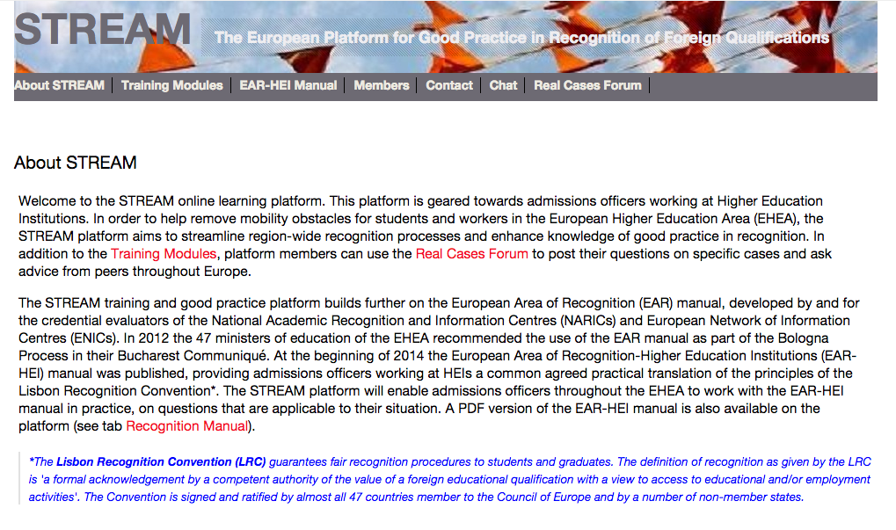
STREAM Platform
4 training modules:
Introduction to recognition
Quality & Legitimacy
Credential Evaluation and Assessing
Information Search

Slide 12
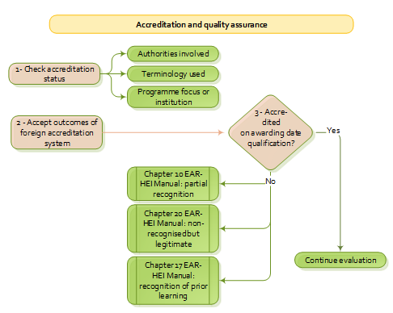
Flowcharts
Key messages
Examples
Exercises
Quiz (test your knowledge)

Slide 13
Useful links:
EAR-HEI manual
Sign Up for STREAM - STREAM (ning.com)
Spotlight on recognition (eua.eu)
Spotlight webinar, 29 April, 14.00-15.00 CET:
Smooth recognition of academic qualifications: The role of quality assurance (eua.eu)

