Slide 1
Baltic States towards automatic recognition
Solvita silina
Academic Information Centre – Latvian ENIC/NARIC
Head of Department of Diploma Recognition
Search Engine project “1st Introductory webinar on Automatic Recognition of Foreign Education”, 25.03.2021.

Slide 2
Academic Information Centre founded in 1994, implements activities delegated by the Ministry of Education and Science
Department of Diploma recognition –
Latvian ENIC/NARIC
since 1995
Quality Agency for Higher Education
since 2015
Projects Department
Search Engine project “1st Introductory webinar on Automatic Recognition of Foreign Education”, 25.03.2021.

Slide 3
Department of Diploma Recognition
Since 1995 AIC is a member of ENIC/NARIC network (www.enic-naric.net)
Recognition of Foreign Diplomas:
- Academic recognition of foreign qualifications - to continue education or work in non-regulated professions
AIC evaluation statement
HEIs make a decision based on AIC statement
- Since 2003 – Assistance Centre for Professional recognition of foreign qualifications - to work in a regulated professions;
Database of Regulated professions in Latvia: http://www.aic.lv/regdip/
Recognition of Pre- Bologna Diplomas in Latvia
Automatic academic recognition in Baltic States
www.aic.lv
section «Recognition of Foreign Diplomas»
Search Engine project “1st Introductory webinar on Automatic Recognition of Foreign Education”, 25.03.2021.

Slide 4
Baltic States towards automatic recognition
Background:
Making recognition among Baltic States more open
Avoiding bureaucratic burdens
Increasing mutual trust
Search Engine project “1st Introductory webinar on Automatic Recognition of Foreign Education”, 25.03.2021.

Slide 5
Aurbell project 2014-2016
Search Engine project “1st Introductory webinar on Automatic Recognition of Foreign Education”, 25.03.2021.

Slide 6
Aurbell project 2014-2016
Educational systems
Quality assessment
Recognition practices
Proposal for mutual agreement
Comparative study report: http://www.aic.lv/portal/content/files/AURBELL_report_EN.pdf
Search Engine project “1st Introductory webinar on Automatic Recognition of Foreign Education”, 25.03.2021.

Slide 7
Aurbell project 2014-2016
Comparative study of:
Access requirements
Structure of qualifications – Components, ECTS
Workload
Graduation requirements
Type of awarding institutions
Access to further studies
Formal rights to employment
Diploma Supplement
Quality Assurance
Qualifications Framework/Learning outcomes
Search Engine project “1st Introductory webinar on Automatic Recognition of Foreign Education”, 25.03.2021.

Slide 8
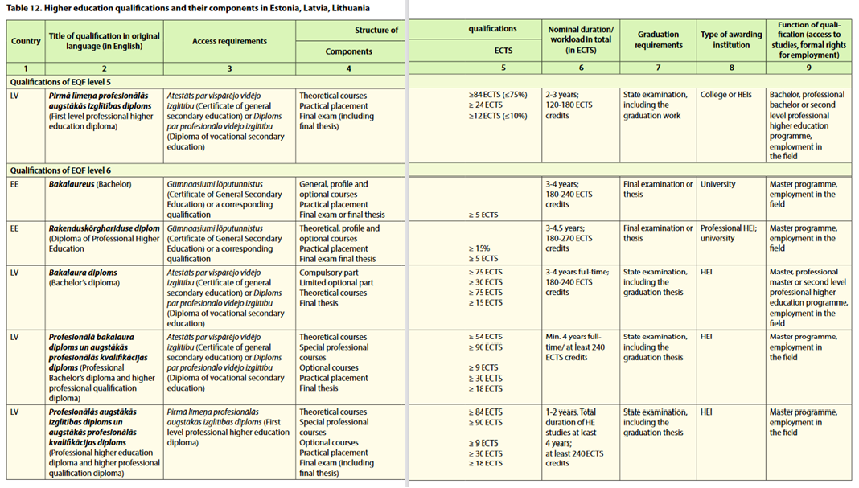
Search Engine project “1st Introductory webinar on Automatic Recognition of Foreign Education”, 25.03.2021.

Slide 9
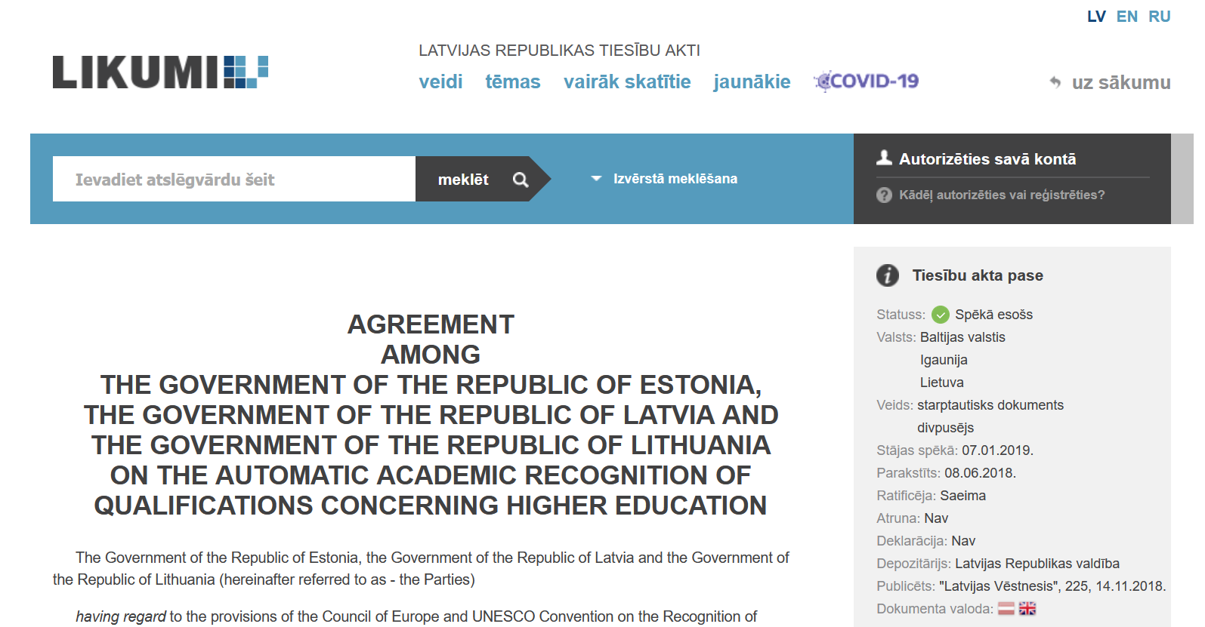
Aurbell project (2014-2016) / Agreement (2019)
Search Engine project “1st Introductory webinar on Automatic Recognition of Foreign Education”, 25.03.2021.

Slide 10
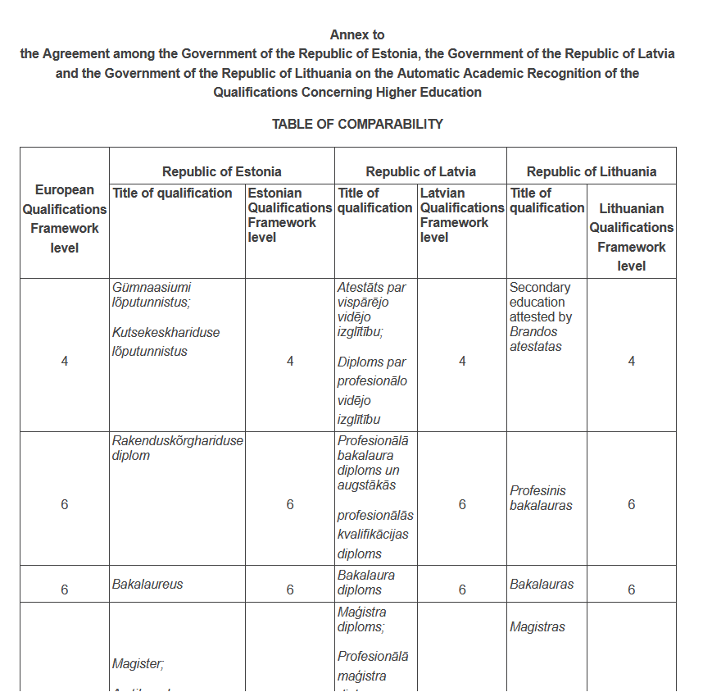
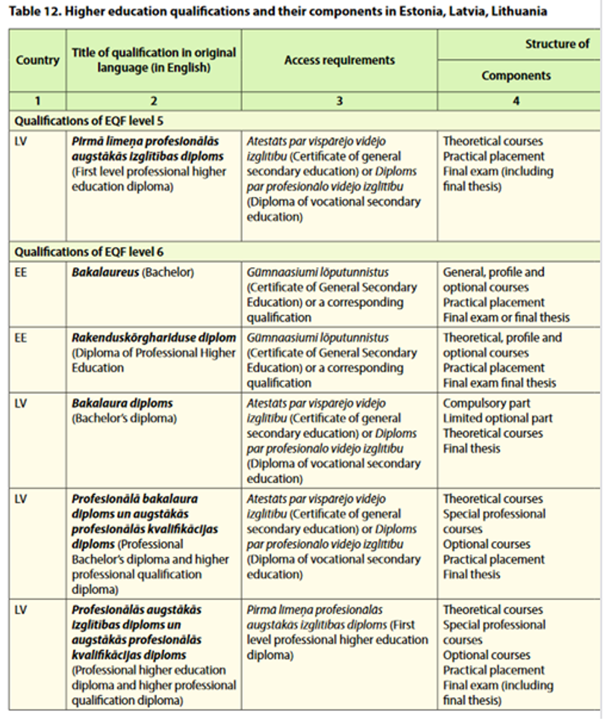
Aurbell project (2014-2016) / Agreement (2019)
Search Engine project “1st Introductory webinar on Automatic Recognition of Foreign Education”, 25.03.2021.

Slide 11
Aurbell project
2014-2016
Agreement signed
08.06.2018
Agreement comes into force
07.01.2019
Search Engine project “1st Introductory webinar on Automatic Recognition of Foreign Education”, 25.03.2021.

Slide 12
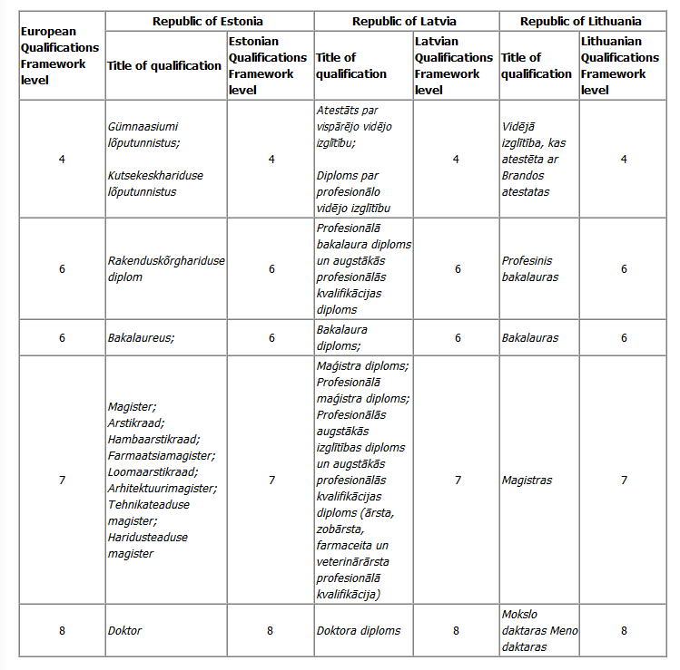
Table of comparability
*Annex to the Agreement among the Government of the Republic of Estonia, the Government of the Republic of Latvia and the Government of the Republic of Lithuania on the Automatic Academic Recognition of the Qualifications Concerning Higher Education
Search Engine project “1st Introductory webinar on Automatic Recognition of Foreign Education”, 25.03.2021.

Slide 13
From theory to practice
Positive aspects:
List of HEIs
National Qualifications Framework
Accredited qualifications
Challenges:
2 recognition procedures for the same country
Small number of cases
Search Engine project “1st Introductory webinar on Automatic Recognition of Foreign Education”, 25.03.2021.

Slide 14
Erasmus+ NARIC project “Comparing qualifications for reliable recognition” (QUATREC) 2018-2020
Structure of comparison fiche:
Contextual information:
Title of qualification
Level of NQF/EQF
Information about studies leading to the qualification
Formal rights
Awarding institution
Diploma Supplement
Quality assurance
Learning outcomes
Information about learning outcomes
Learning outcomes as defined by qualification authority
Analysis of three selected qualifications between Latvia, Estonia, Bulgaria, UK, Armenia:
Bachelor’s degree in Physics (EQF level 6)
Master’s degree in Psychology (EQF level 7)
Master’s degree in Business Administration (EQF level 7)
Search Engine project “1st Introductory webinar on Automatic Recognition of Foreign Education”, 25.03.2021.

Slide 15
Comparative analysis of the context information: Bachelor’s degree in Physics
 | Similarities | Differences
Level of NQF/EQF | All partner countries – the same level of EQF (level 6) | ARM, BG, EE, LV – NQF level 6 UK – NQF level 6 in England, Wales and Northern Ireland, NQF levels 9 or 10 in Scotland
Access requirements | All partner countries – secondary school qualification with access rights to HE | LV and UK – more detailed requirements, e.g. specific grades or points in certain study subjects UK – IELTS exam score 6.5 overall (minimum 6.0 in all elements) for non-native speakers of English
Admission requirements | ARM, EE and LV – national language exam results ARM, BG, EE and LV – exam in physics or mathematics (UK not specified) ARM, BG, EE and LV – a specific grade in the state exams and average school grades (UK not specified) | UK – in some cases an interview and an admission test
Workload (amount of ECTS credits) | ARM, EE, LV, UK – 180 ECTS credits | BG – 240 ECTS credits
Mode of study | ARM, LV – only full-time studies | BG, EE and UK – full-time and part-time studies
Profile | All partner countries – academically oriented profile | ARM and EE – both academically and professionally oriented profile
Access to further studies | All partner countries – access to the second cycle programmes | UK – access to the third cycle programmes is discretion of HEIs
Professional rights | ARM, BG, EE and LV – the qualification leads to a non-regulated profession | UK – the qualification leads to a chartered physicist, which is a regulated profession
Requirements for graduation | ARM, BG, EE and LV – final thesis | ARM, BG, EE and LV – final thesis is worth different amount of ECTS credits UK – every study year different requirements
Awarding of qualification
Awarding body | All partner countries – HEI
Diploma Supplement is awarded (Yes/No) | BG, EE, LV and ARM – Y BG, EE, LV and ARM – DS in national language and in English |  | UK – N (some HEIs issue the DS but it is not mandatory)

Slide 16
Recognition of these qualifications
Considering the contextual information and learning outcomes:
Bachelor’s degree in Physics could be automatically recognised between the partner countries in terms of the qualification level (EQF level 6)
Master’s degree in Psychology could be automatically recognised between the partner countries in terms of further access to the doctoral studies
Master’s degree in Business Administration could be automatically recognised between the partner countries
Regarding the contextual information, all the three qualifications could be automatically recognised between all the partner countries
Differences or variations in the learning outcomes acceptable for them not to be a substantial obstacle for automatic recognition should still be explored and determined
http://www.aic.lv/portal/en/par-aic/projects/quatrec
Search Engine project “1st Introductory webinar on Automatic Recognition of Foreign Education”, 25.03.2021.

Slide 17
Benelux and Baltic Agreement
Treaty of Automatic Recognition For Higher Education
Estonia
Latvia
Lithuania
The Netherlands
Belgium
Luxembourg
Refer to Higher Education qualifications
Referenced to EQF
Quality Assessment
Search Engine project “1st Introductory webinar on Automatic Recognition of Foreign Education”, 25.03.2021.

Slide 18
Academic Information Centre
Address: Dzirnavu Street 16 (3rd floor), Riga, LV-1010
Phone.: (+371) 67 225 155
E-mail: aic@aic.lv
Website: www.aic.lv
Search Engine project “1st Introductory webinar on Automatic Recognition of Foreign Education”, 25.03.2021.

