Slide 1
Tools to foster Automatic Recognition
Silvia Bianco – CIMEA
1st Introductory webinar on Automatic Recognition of Foreign Education
SEARCH ENGINE project
25.03.2021

Slide 2
The Q-ENTRY database

Slide 3
Q-ENTRY:
International Database on Higher Education Entry Qualifications
AUTOMATIC RECOGNITION
We will ensure automatic recognition of academic qualifications and periods of study within the EHEA so that students, staff and graduates are able to move freely to study, teach and do research.
Rome Communiqué, November 19th 2020
ACCESS TO HIGHER EDUCATION
The Council of the European Union ... hereby welcomes the Commission’s Intention to: 14. Establish a user-friendly EU online information service of upper secondary qualifications giving access to higher education in each Member State.
Proposal for a Council Recommendations on promoting automatic mutual recognition of higher education and upper secondary education diplomas and the outcomes of learning periods abroad, May 22nd 2018

Slide 4
Q-ENTRY project
qENTRY+ project
2018-2020 Q-ENTRY: International Database on Higher Education Entry Qualifications
5 NARICs - Italy, France, Ireland, Latvia, Norway
2020-2022 qENTRY+: International Database on Higher Education Entry Qualifications
5 NARICs – Italy, Belgium Flemish Community, Bulgaria, The Netherlands, Poland

Slide 5
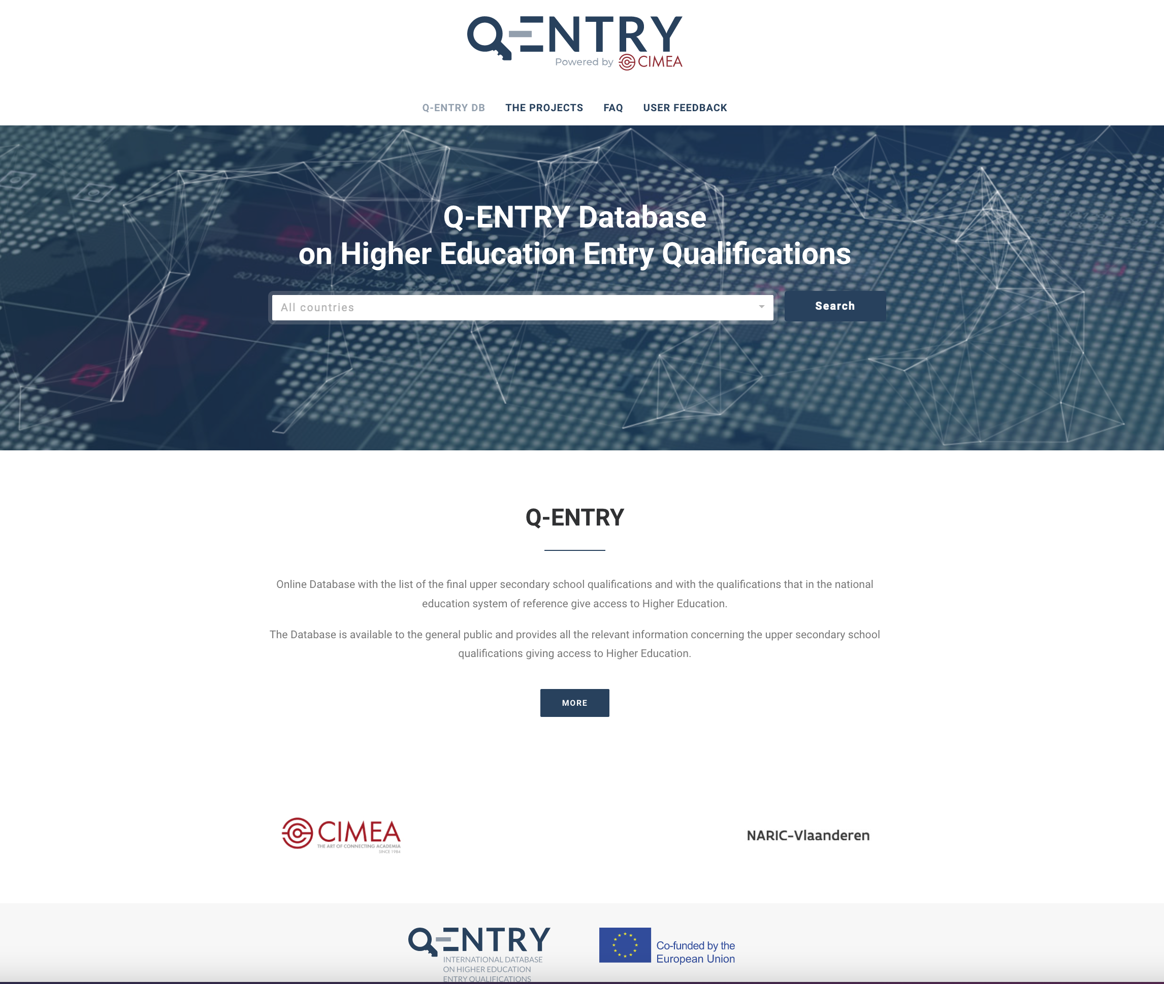
DE FACTO AR
102 qualifications giving access to higher education
55 countries
International Baccalaureate
European Baccalaureate
Link: http://www.q-entry.eu/

Slide 6
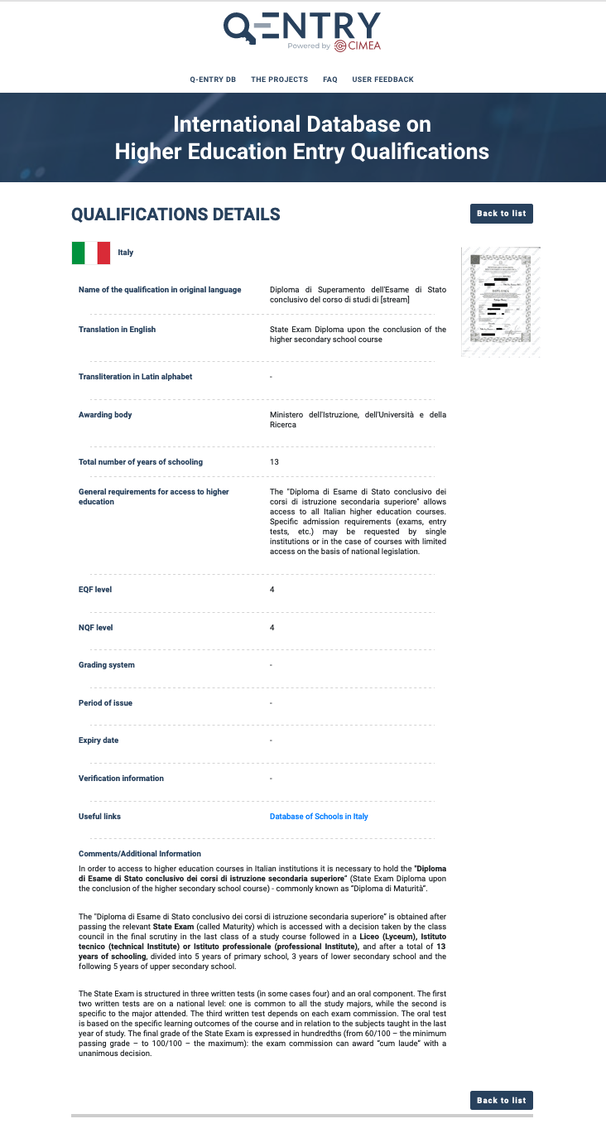
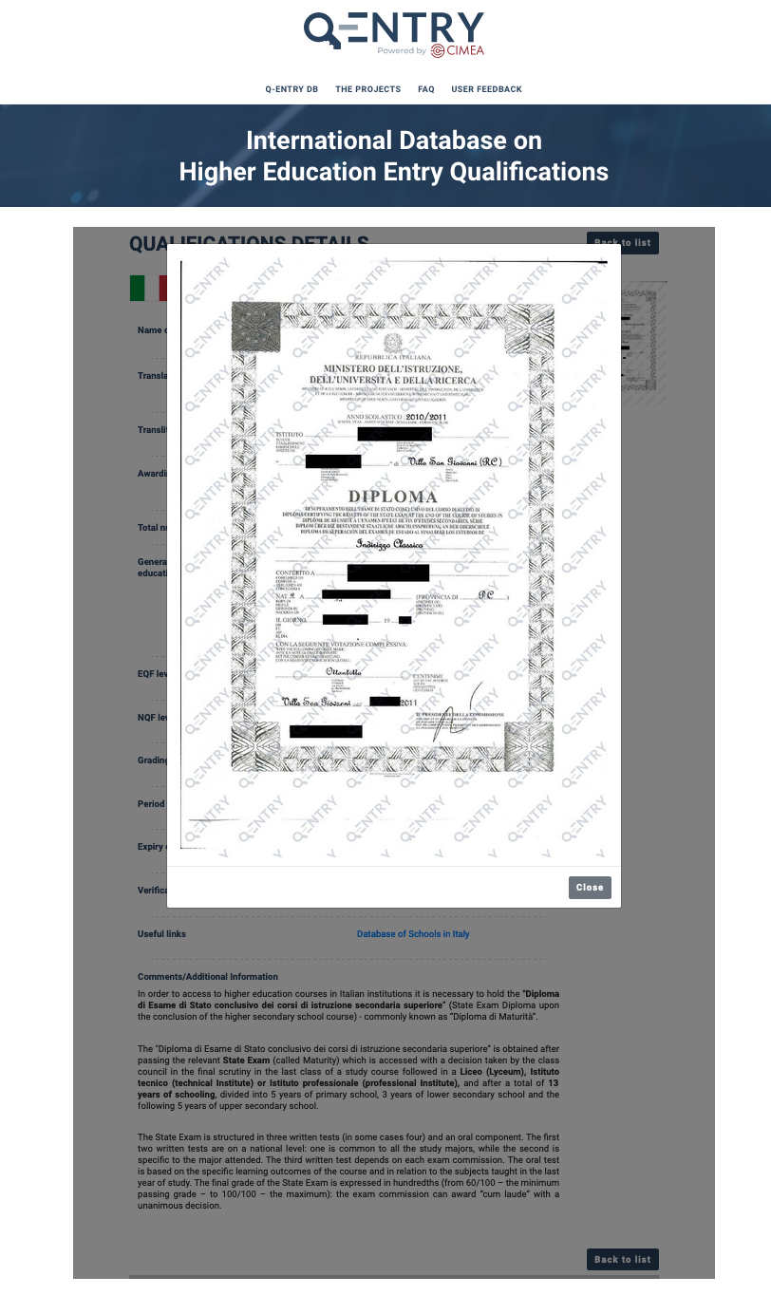

Slide 7
The AdReN project

Slide 8
Context
Where the idea of the AdReN project comes from:
2018 – first meeting of the AdReN network (Albania, Bosnia and Herzegovina, Croatia, Italy, Slovenia)
2019 – second meeting of the AdReN network (Albania, Bosnia and Herzegovina, Italy)
2020-2022 AdReN: Automatic Recognition in the Adriatic Region
4 NARICs: Italy, Croatia, Greece, Slovenia
+ IUAV University of Venice – Italy

Slide 9
AdReN objectives
Objectives of the project
“The Council Recommendations on promoting automatic mutual recognition of higher education and upper secondary education and training qualifications and the outcomes of learning periods abroad states: “[…] a Higher education qualification acquired in one Member State is automatically recognised at the same level, for the purpose of accessing further studies, in the others […]”.
In line with the Council Recommendation, the AdReN project aims at fostering the automatic recognition of academic qualifications and qualifications giving access to higher education in the Adriatic region, starting from project country partners.

Slide 10
Outcomes of the AdReN project
Enhancing and maintaining the AdReN network
Creation of the table of comparison of qualifications (both pre and Bologna)
Study on Substantial Differences and Transnational Education in partner countries

Slide 11
The Diplome platform

Slide 12
CIMEA / 1.1
Diplome – Blockchain based platform
Italy, with CIMEA, is the first country using the blockchain technology in the field of recognition of qualifications.
Why blockchain for recognition:
Digitalization of the recognition process
Student-centered approach
Data security and privacy
Fraud minimization
The concept
Individuals get assigned a secure wallet where they can store their qualifications using the blockchain technology, therefore creating a decentralized, transparent, certified and tamper-proof ecosystem with the goal to simplify the procedure for a student, a graduate or a professional to enroll in a university or to apply for a job in the labour market of another country.

Slide 13
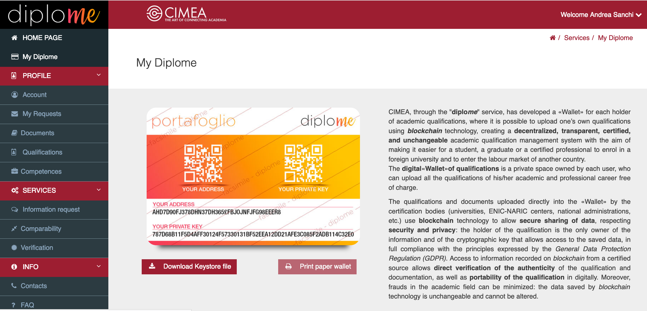
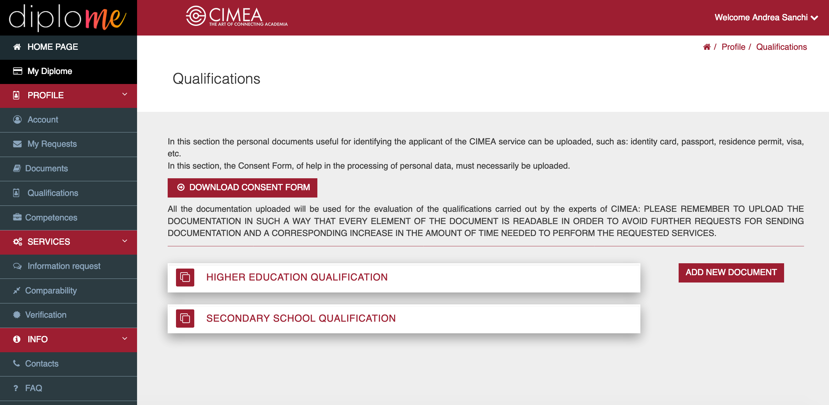
Sneak peek

Slide 14
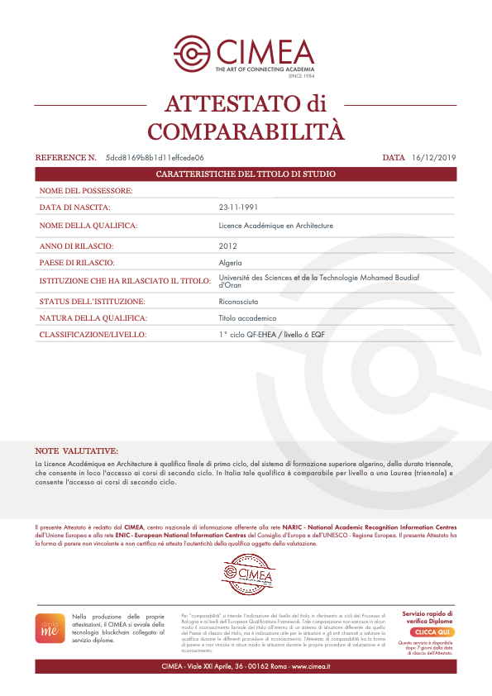
Notes of the credential evaluator
Statement issued via blockchain
Verification

Slide 15
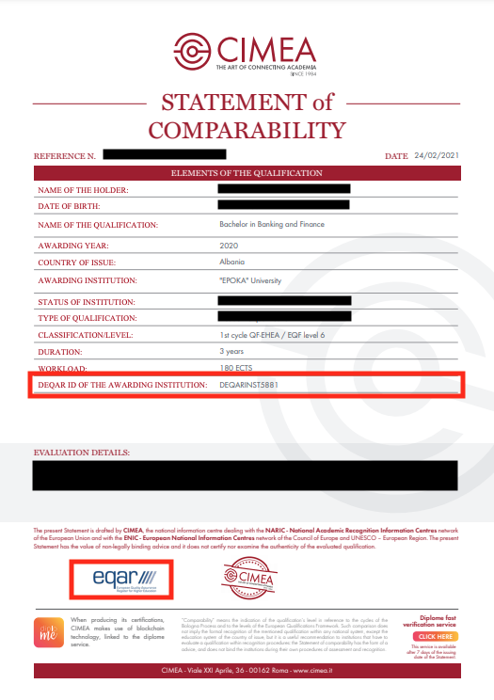
Implementation of the DEQAR database

Slide 16
Thank you!
s.bianco@cimea.it
@CIMEA_Naric
www.cimea.it

